Slide 1
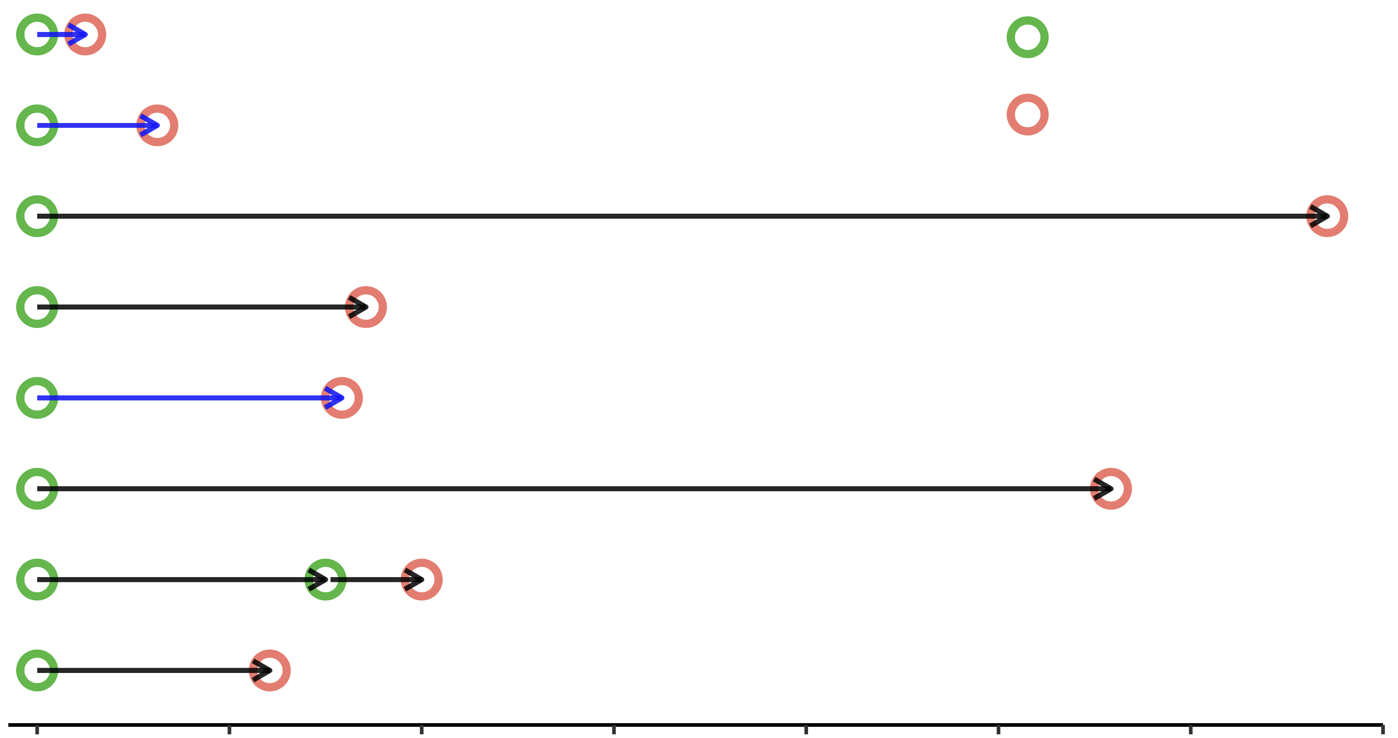
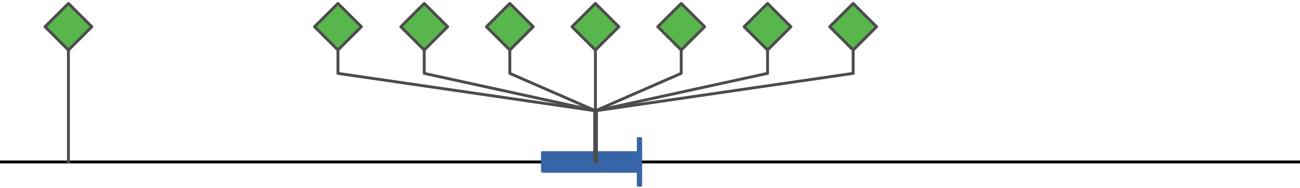
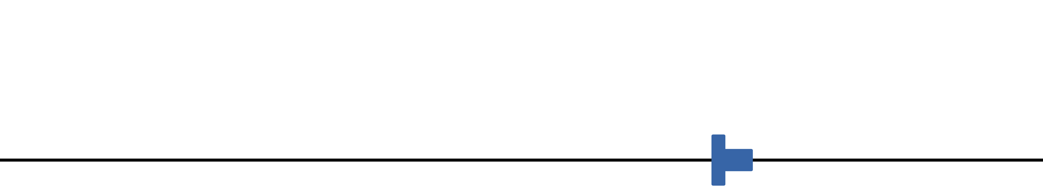
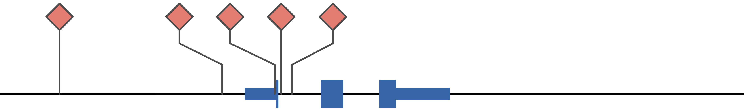
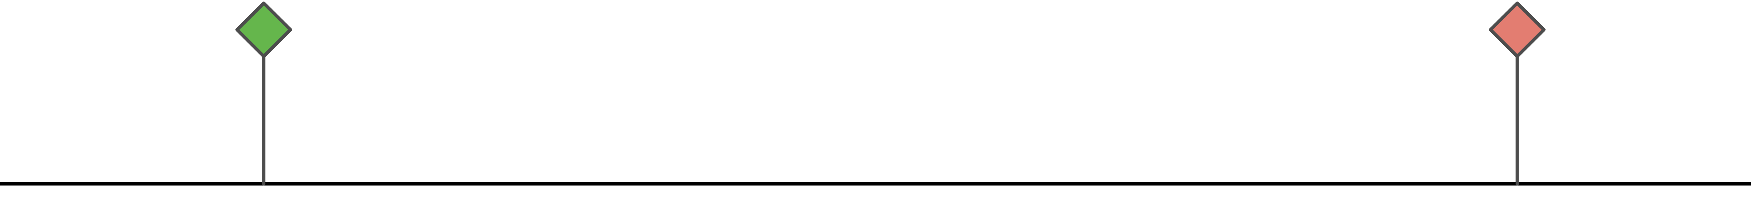
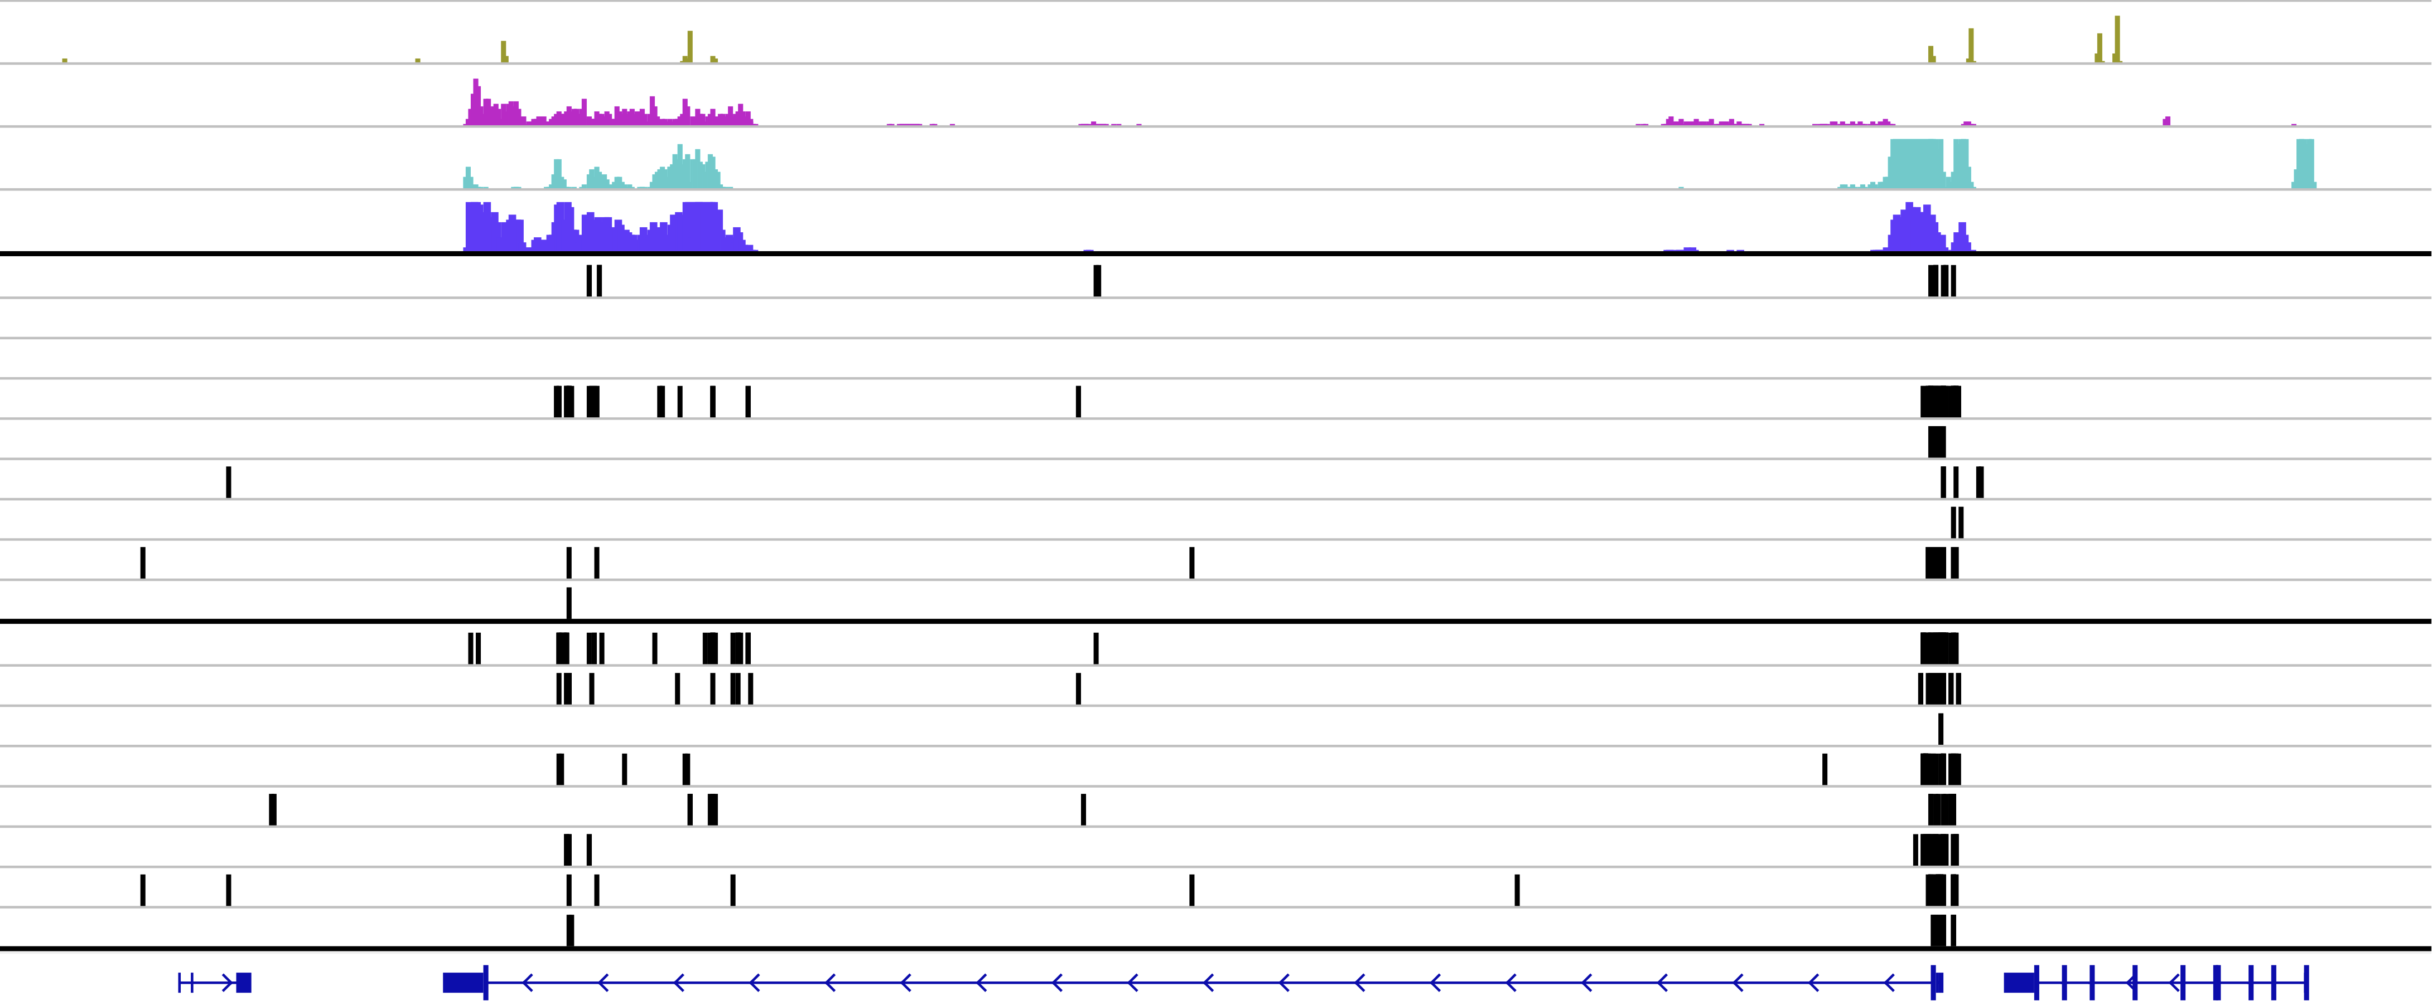
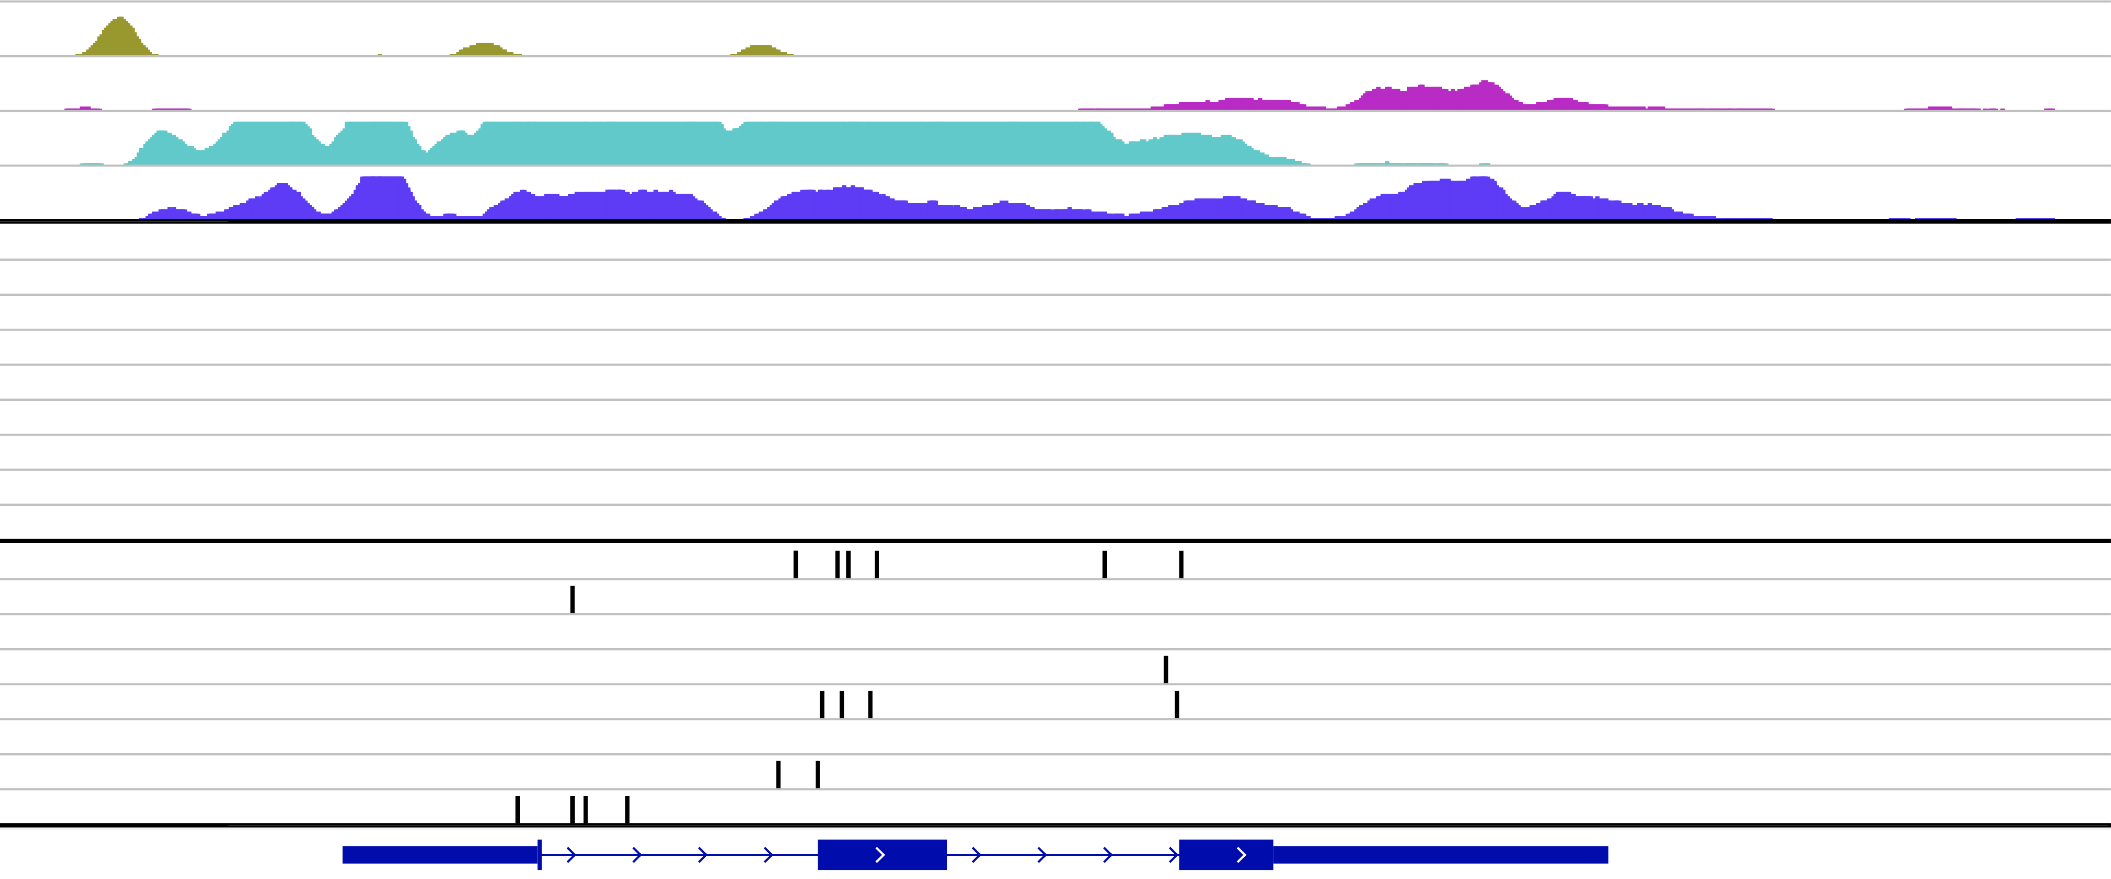
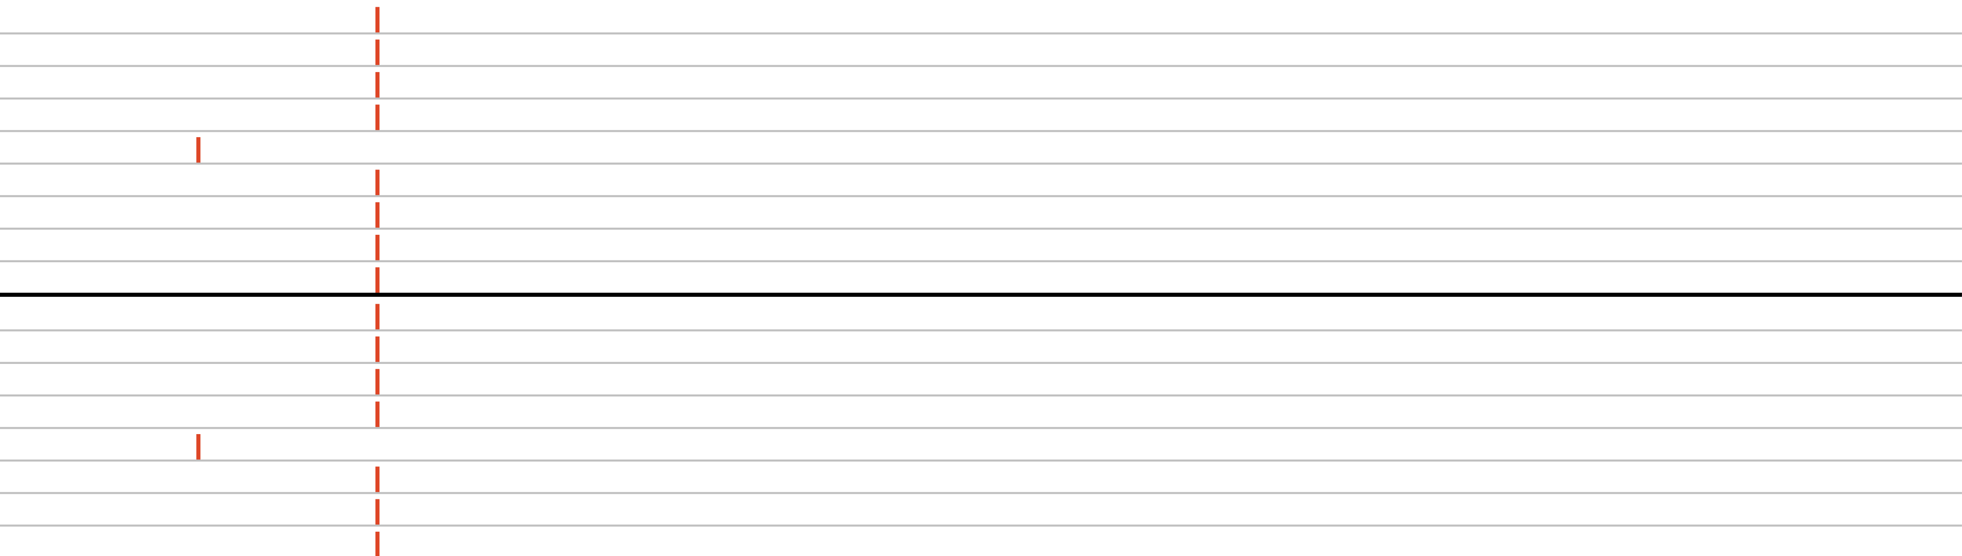
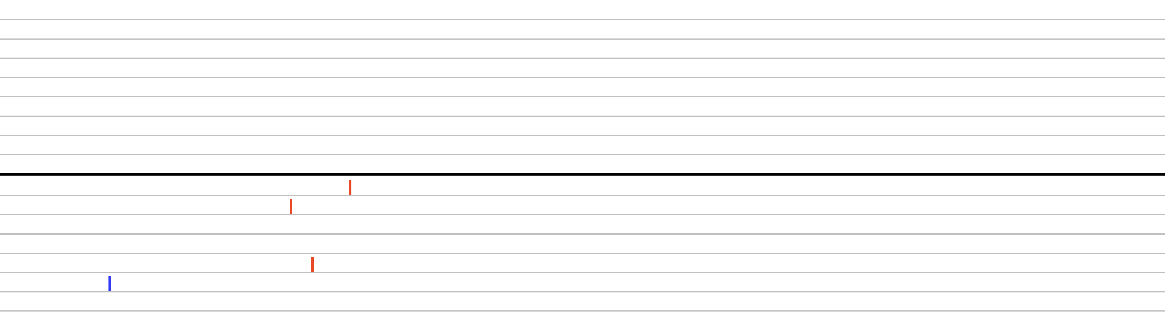
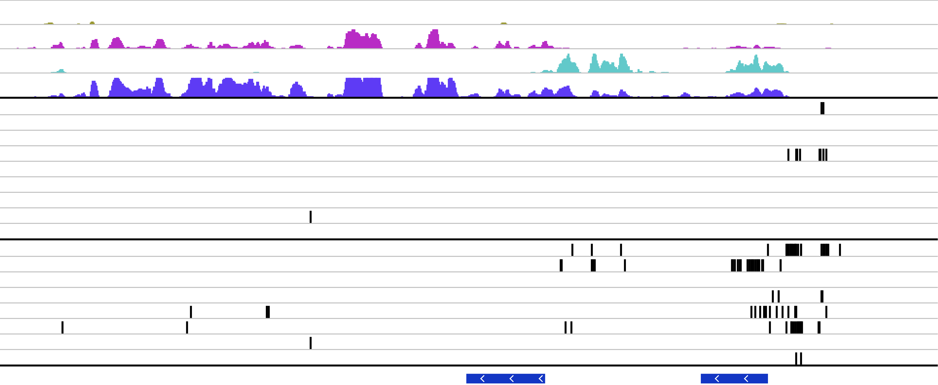
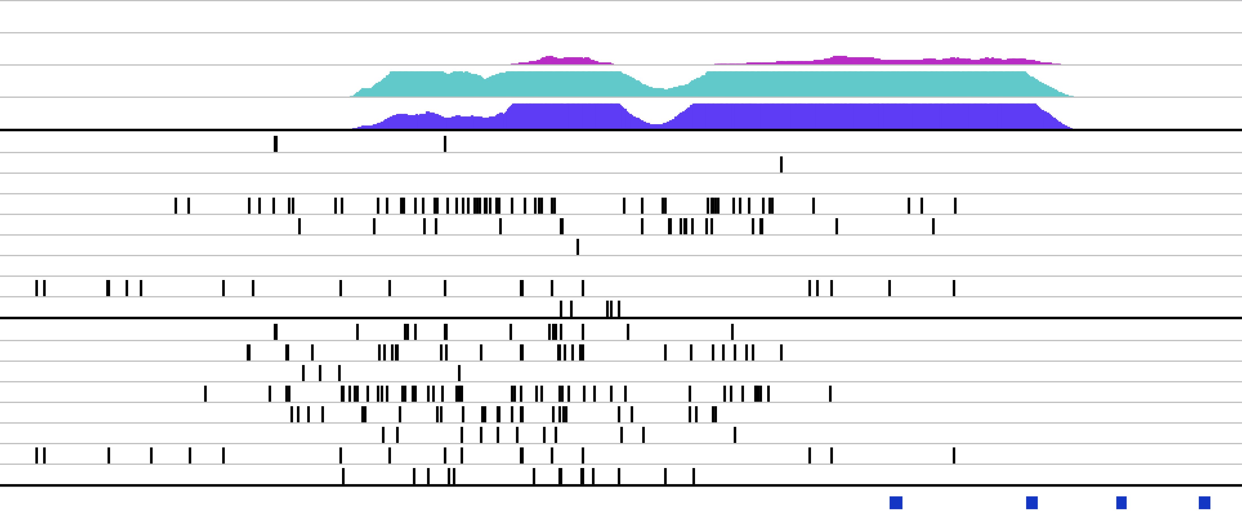
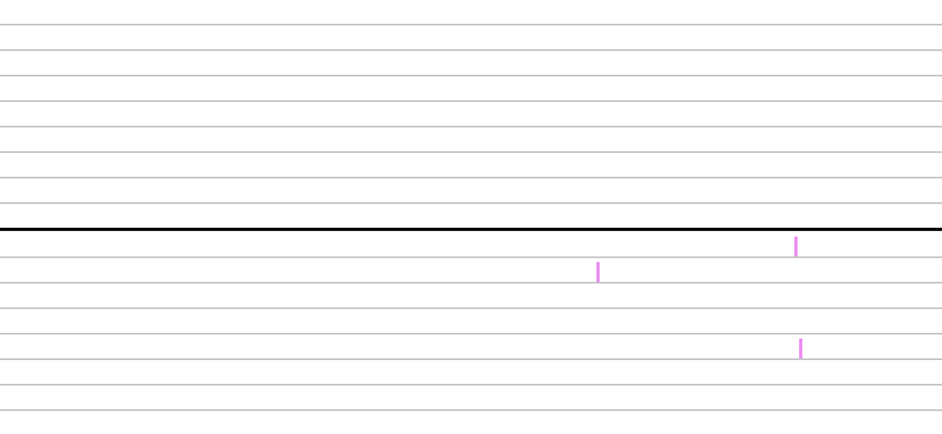
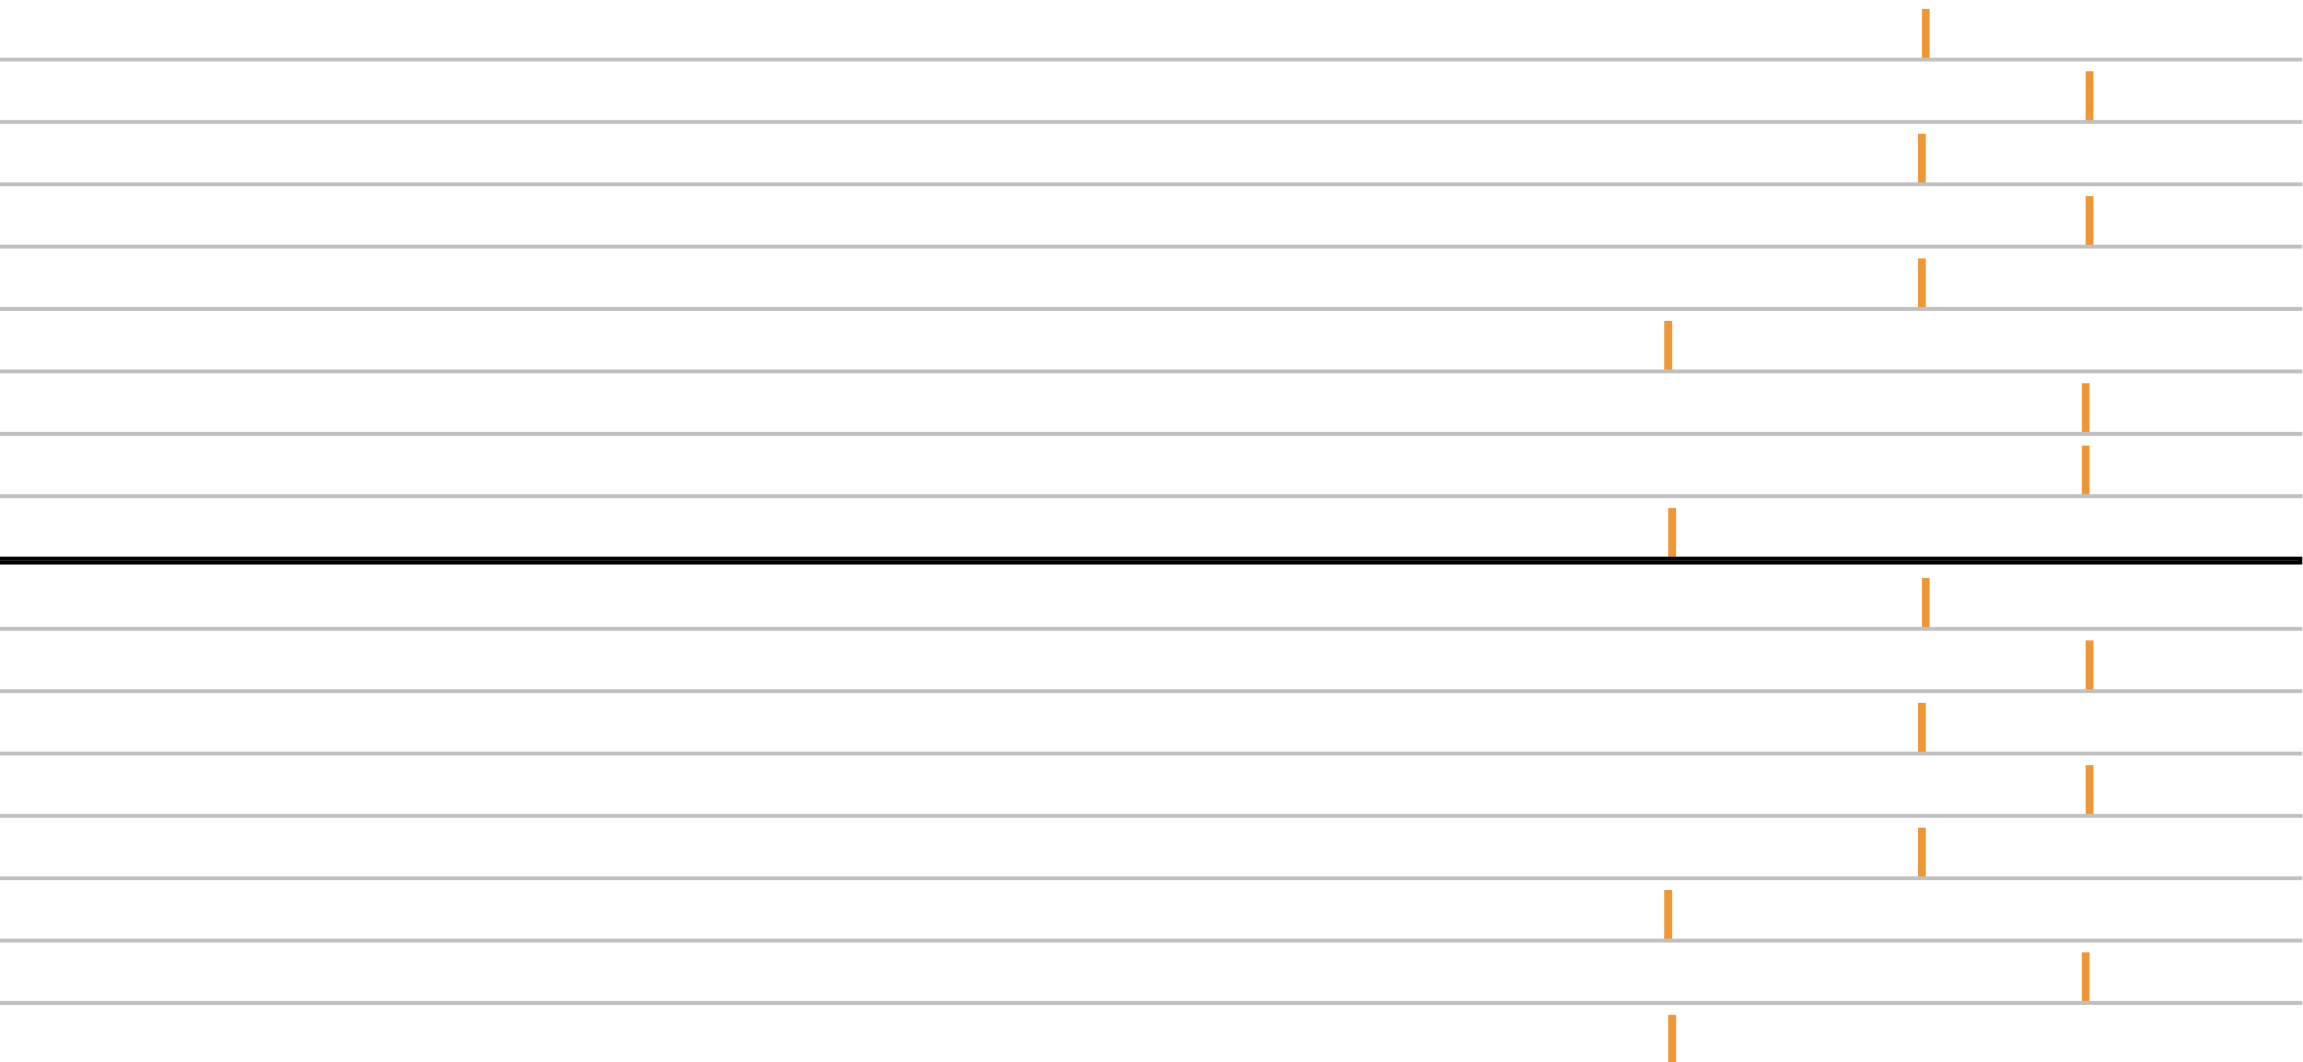
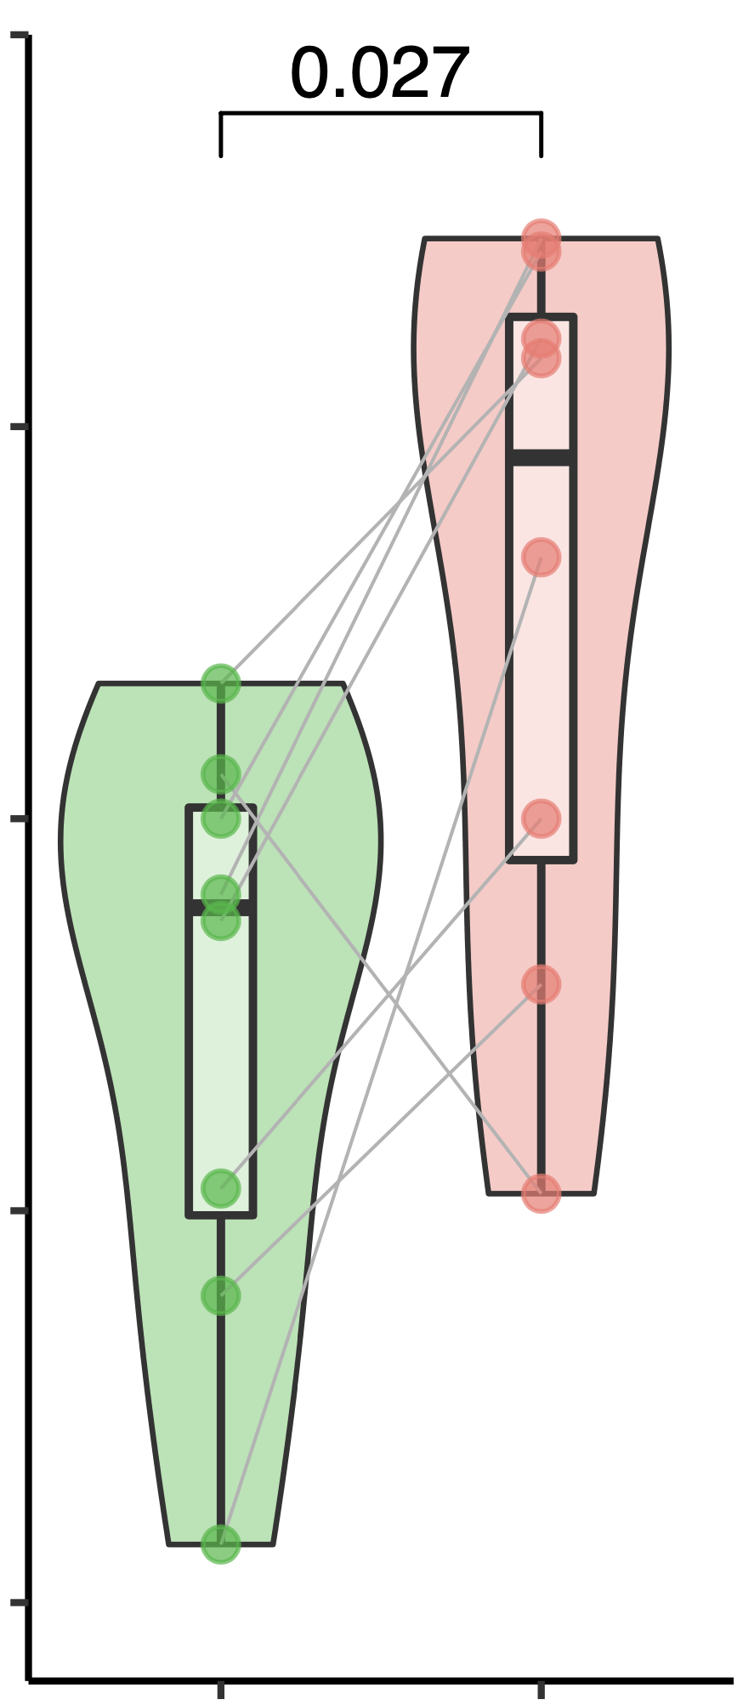
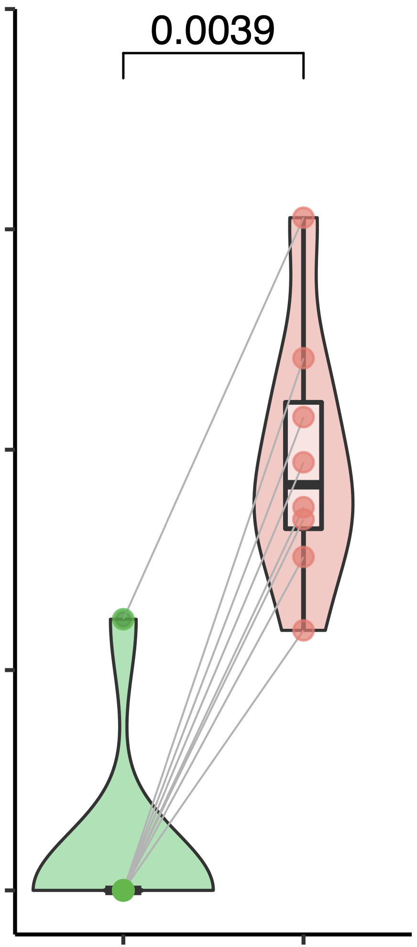
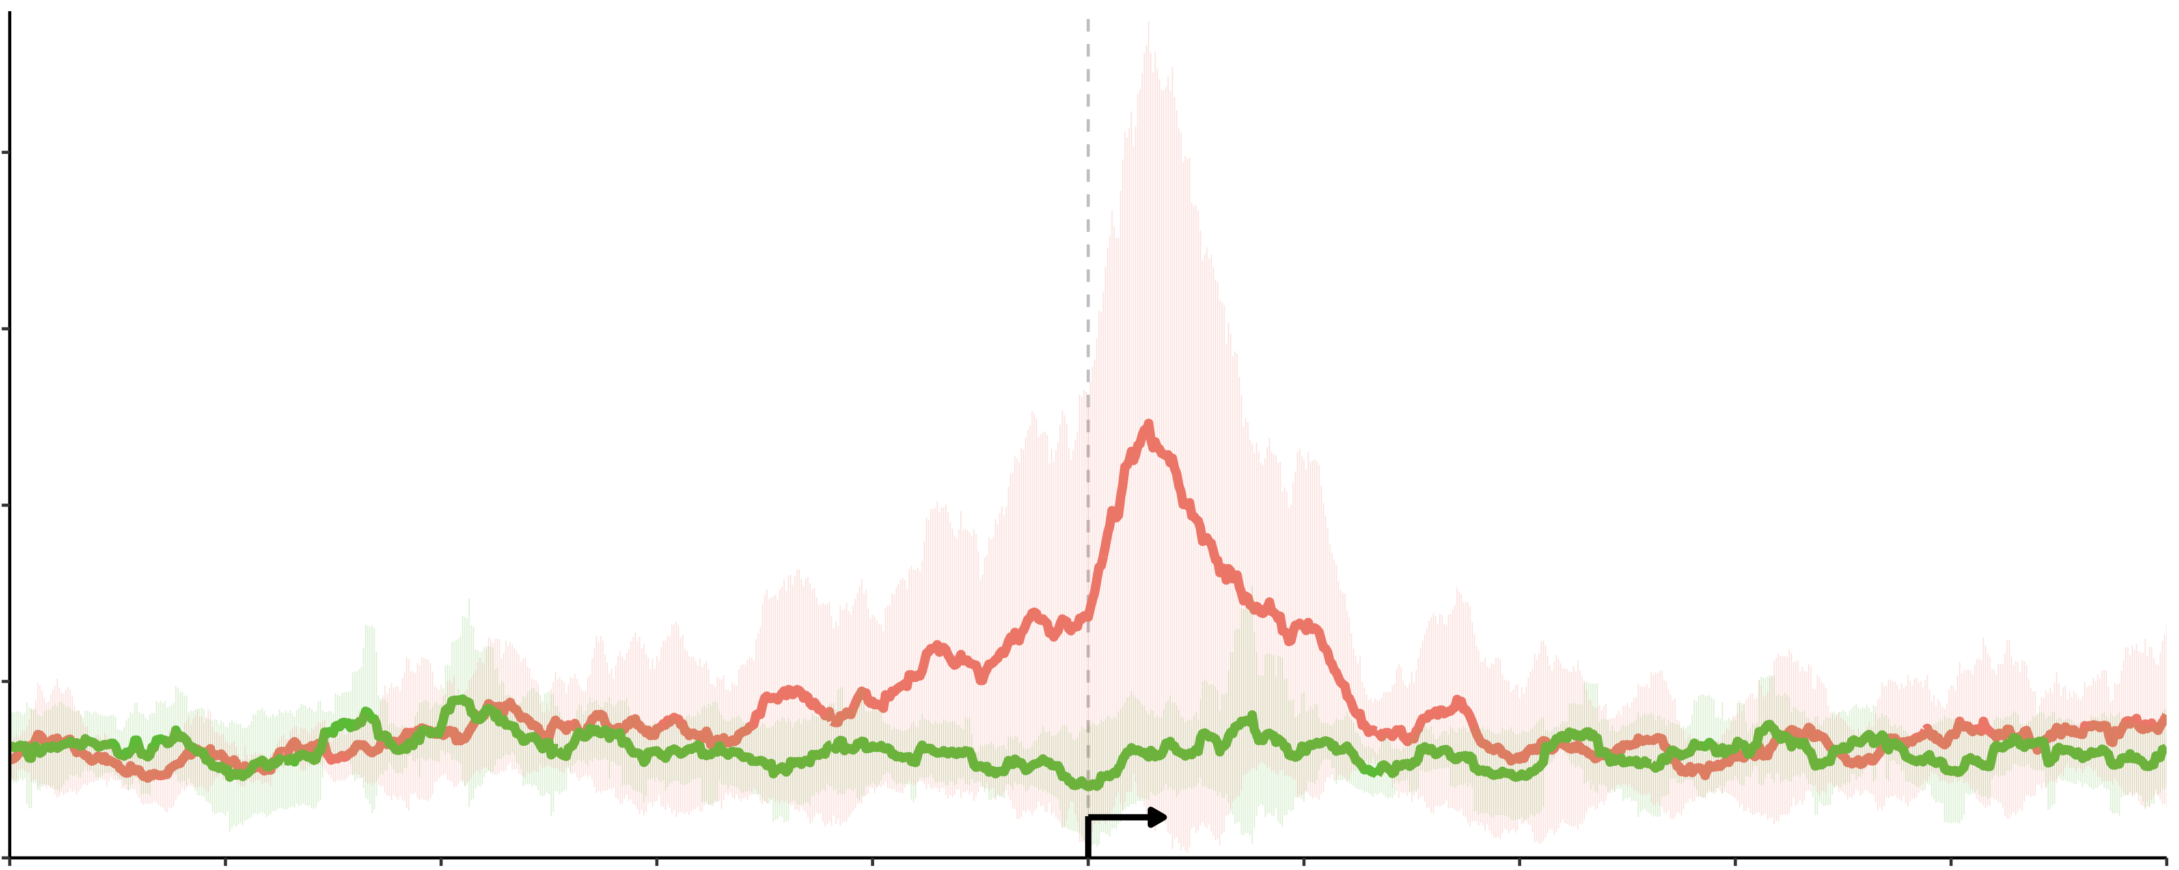
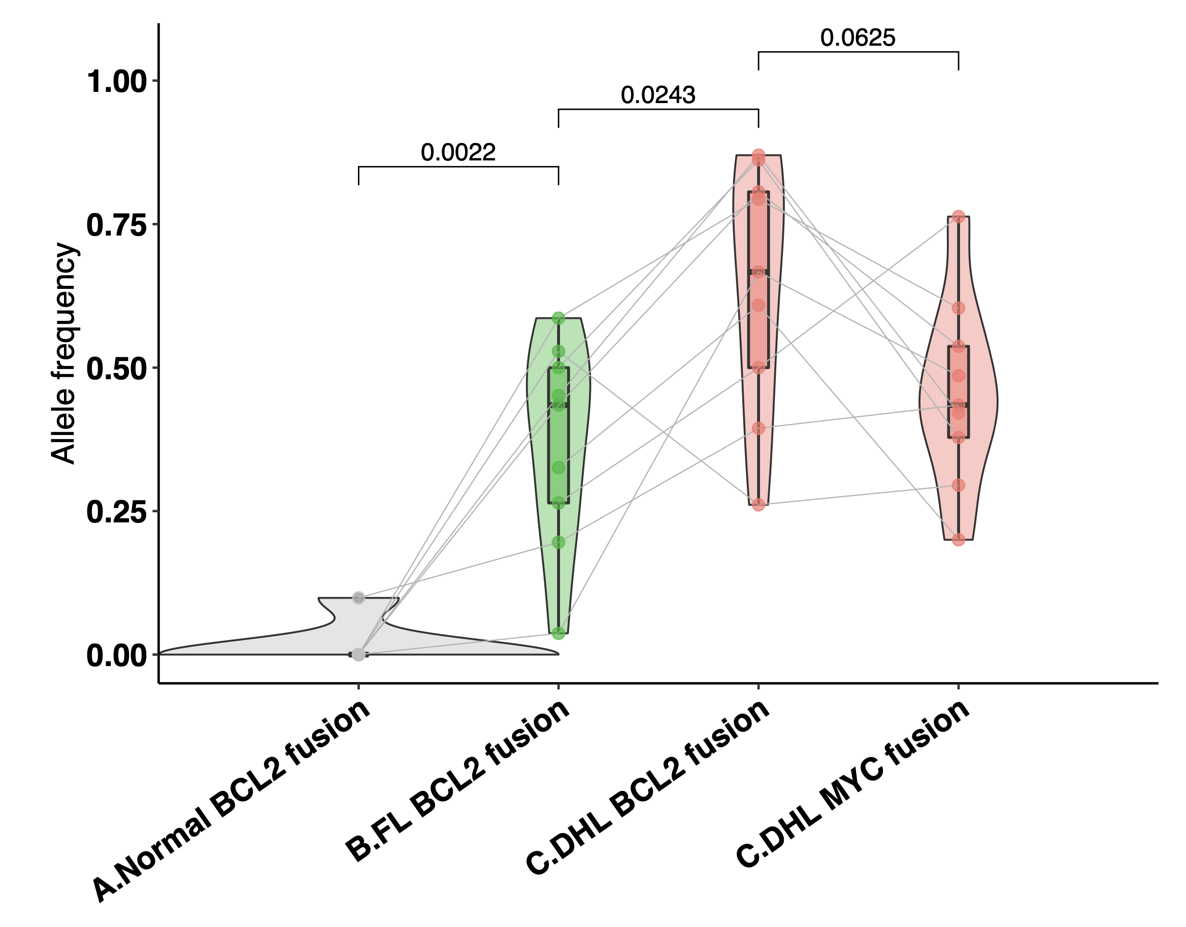
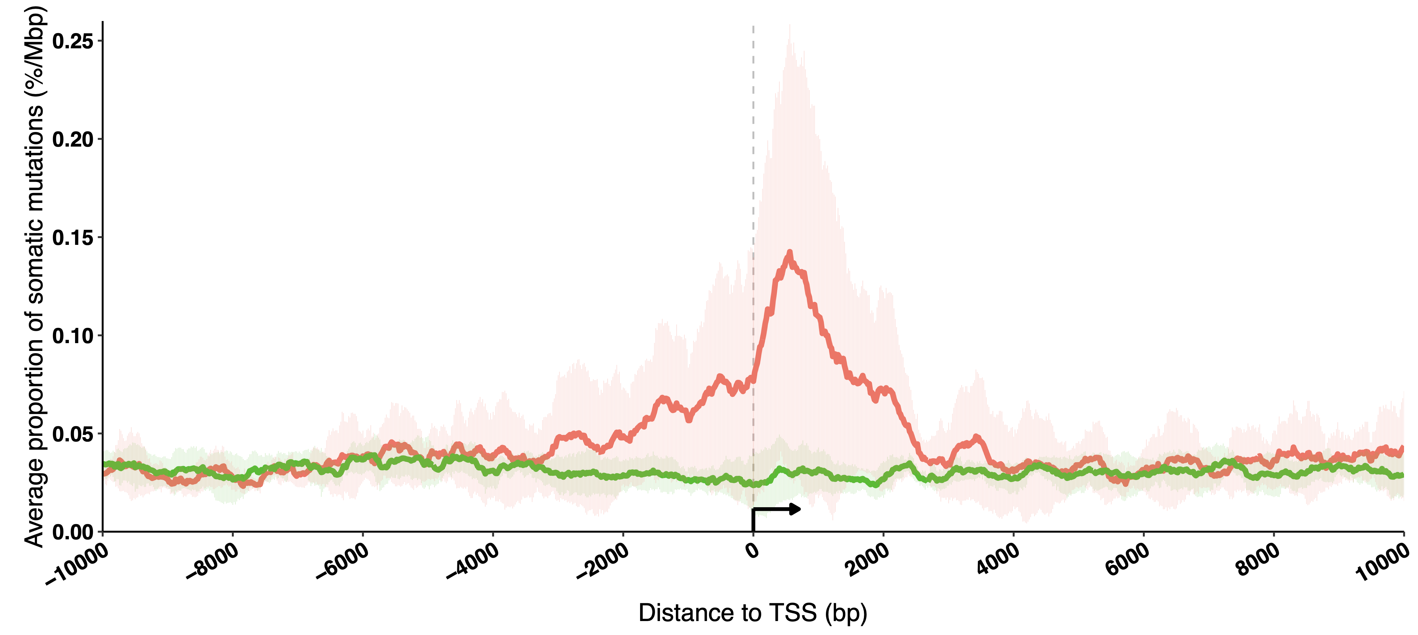
a.
b.
IgH (P6)
IgH (P7)
Both FL & DHL
IgH (P8)
IgH (P9)
IgH (P2)
IgH (P4)
IgH (P1)
P1
FL
IgH (P5)
DHL specific
P2
DHL
chr18
…
P4
63097227
63318081
P5
BCL2
P6
P7
CYRIB (P5)
IRAG2 (P4)
LPP (P7)
LPP (P9)
IgH (P2)
IgH (P6)
P8
a
b
IgH (P1)
IgL (P8)
P9
0
2
4
6
8
10
12
14
chr8
…
……
…
127728571
127769053
128086077
Time after initial diagnosis (year)
MYC
128109219
c.
CTCF
chr18:63,064,788-63,383,469
chr8:127,733,380-127,745,928
H3K4me1
[0-200]
[0-400]
H3K4me3
[0-200]
[0-400]
H3K27ac
[0-200]
[0-400]
[0-400]
P1
[0-400]
P1
P2
P2
P4
P4
P5
FL
P5
P6
P6
P7
P7
P8.a
P8.a
P8.b
P8.b
P9
P9
P1
P1
P2
P2
P4
P4
P5
P5
DHL
P6
P6
P7
P7
P8
P8
P9
P9
XR_935570.2
BCL2
KDSR
MYC
CTCF
chr14:105,555,800-105,611,800
chr14:105,859,204-105,864,775
H3K4me1
[0-200]
[0-200]
H3K4me3
[0-200]
[0-200]
H3K27ac
[0-200]
[0-200]
[0-400]
[0-400]
P1
P1
P2
P2
P4
P4
FL
P5
P5
P6
P6
P7
P7
P8.a
P8.a
P8.b
P8.b
P9
P9
P1
P1
P2
P2
P4
P4
P5
P5
DHL
P6
P6
P7
P7
P8
P8
P9
IgH (C)
A2
E
P9
IgH (J)
J5
J4
J3
Somatic mutation
J6
Translocation to IgH
Translocation to LPP
Translocation to MYC
Translocation to BCL2
d.
1
e.
f.
p = 0.027
1
p = 0.0039
P1,P2,P6,P7,P8,P9
0.75
0.75
0.2
FL
0.5
0.5
0.15
DHL
0.1
AF of BCL2 structural variation
AF of MYC structural variation
Normalized mutation density
0.25
0.25
0.05
0
0
0
TSS
-10
-8
-6
-4
-2
0
2
4
6
8
10
FL
DHL
FL
DHL
Distance to transcription start site (Kb)
P1,P2,P6,P7,P8
Figure 1
Notes:
Sliding window
Zoom in and chi test for right fig

Slide 2
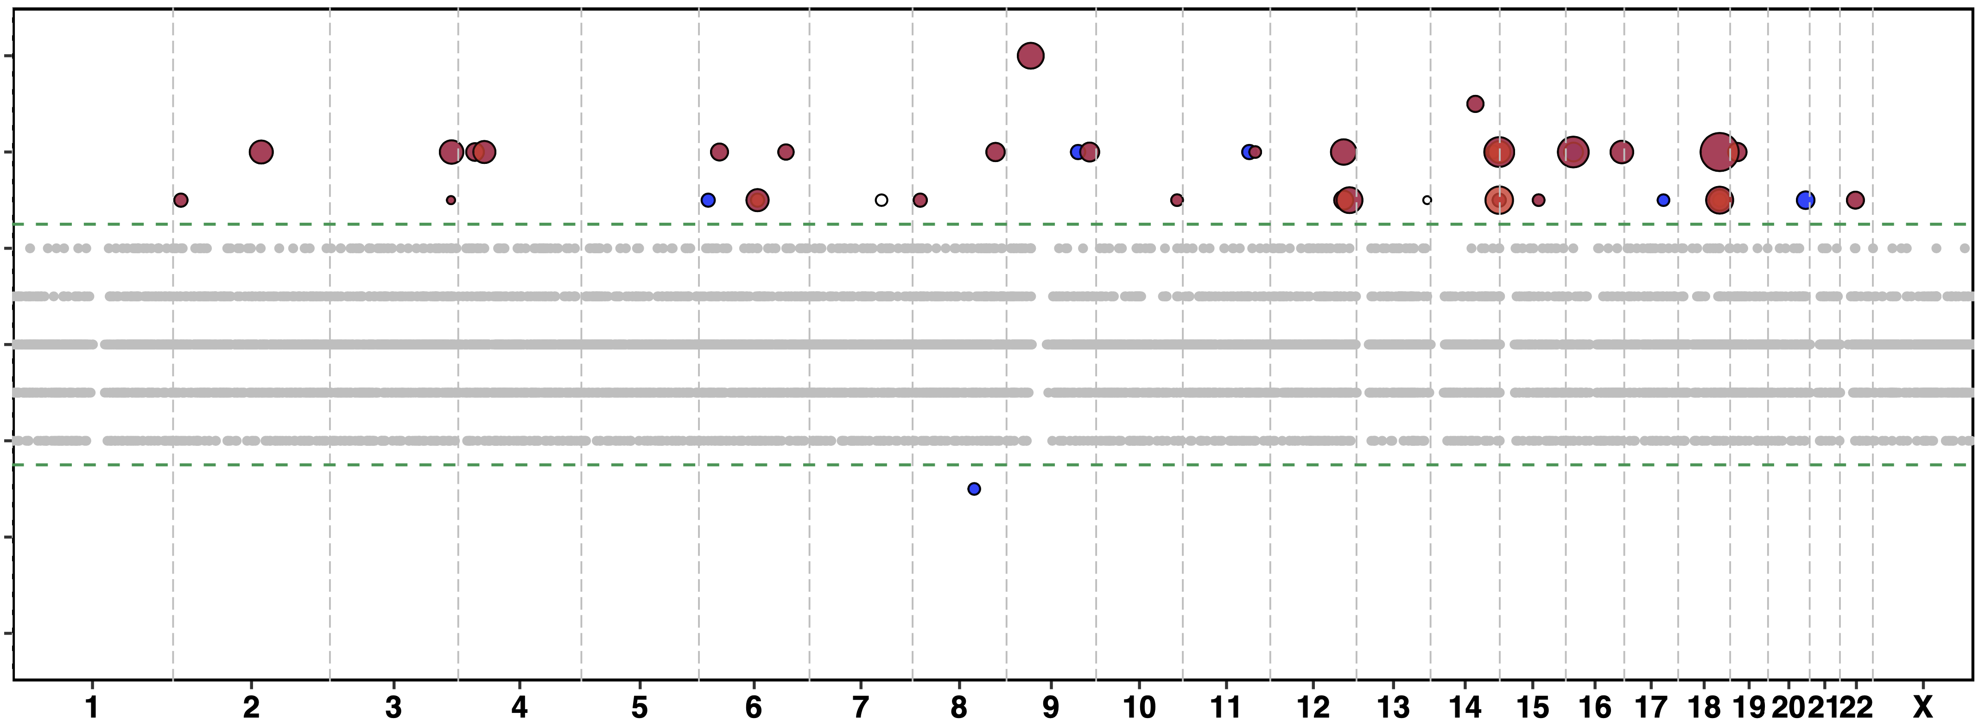
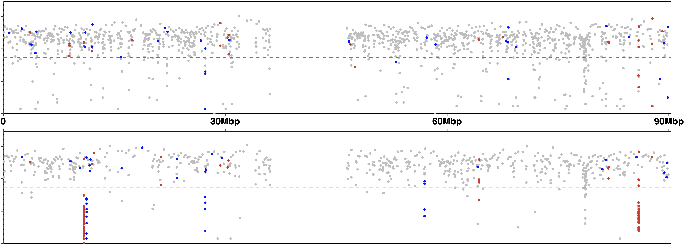
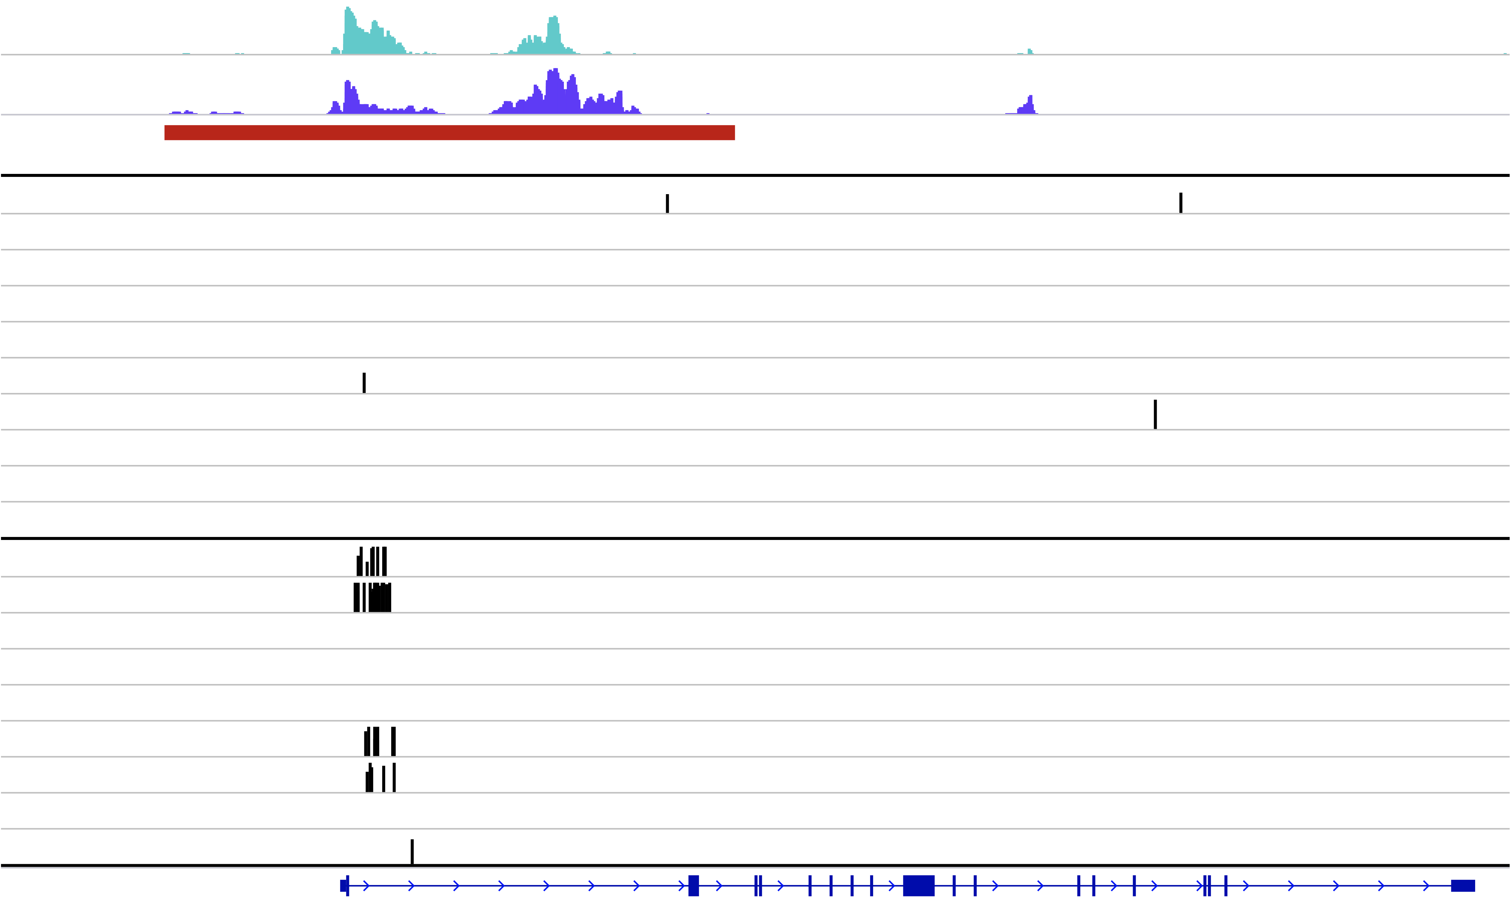
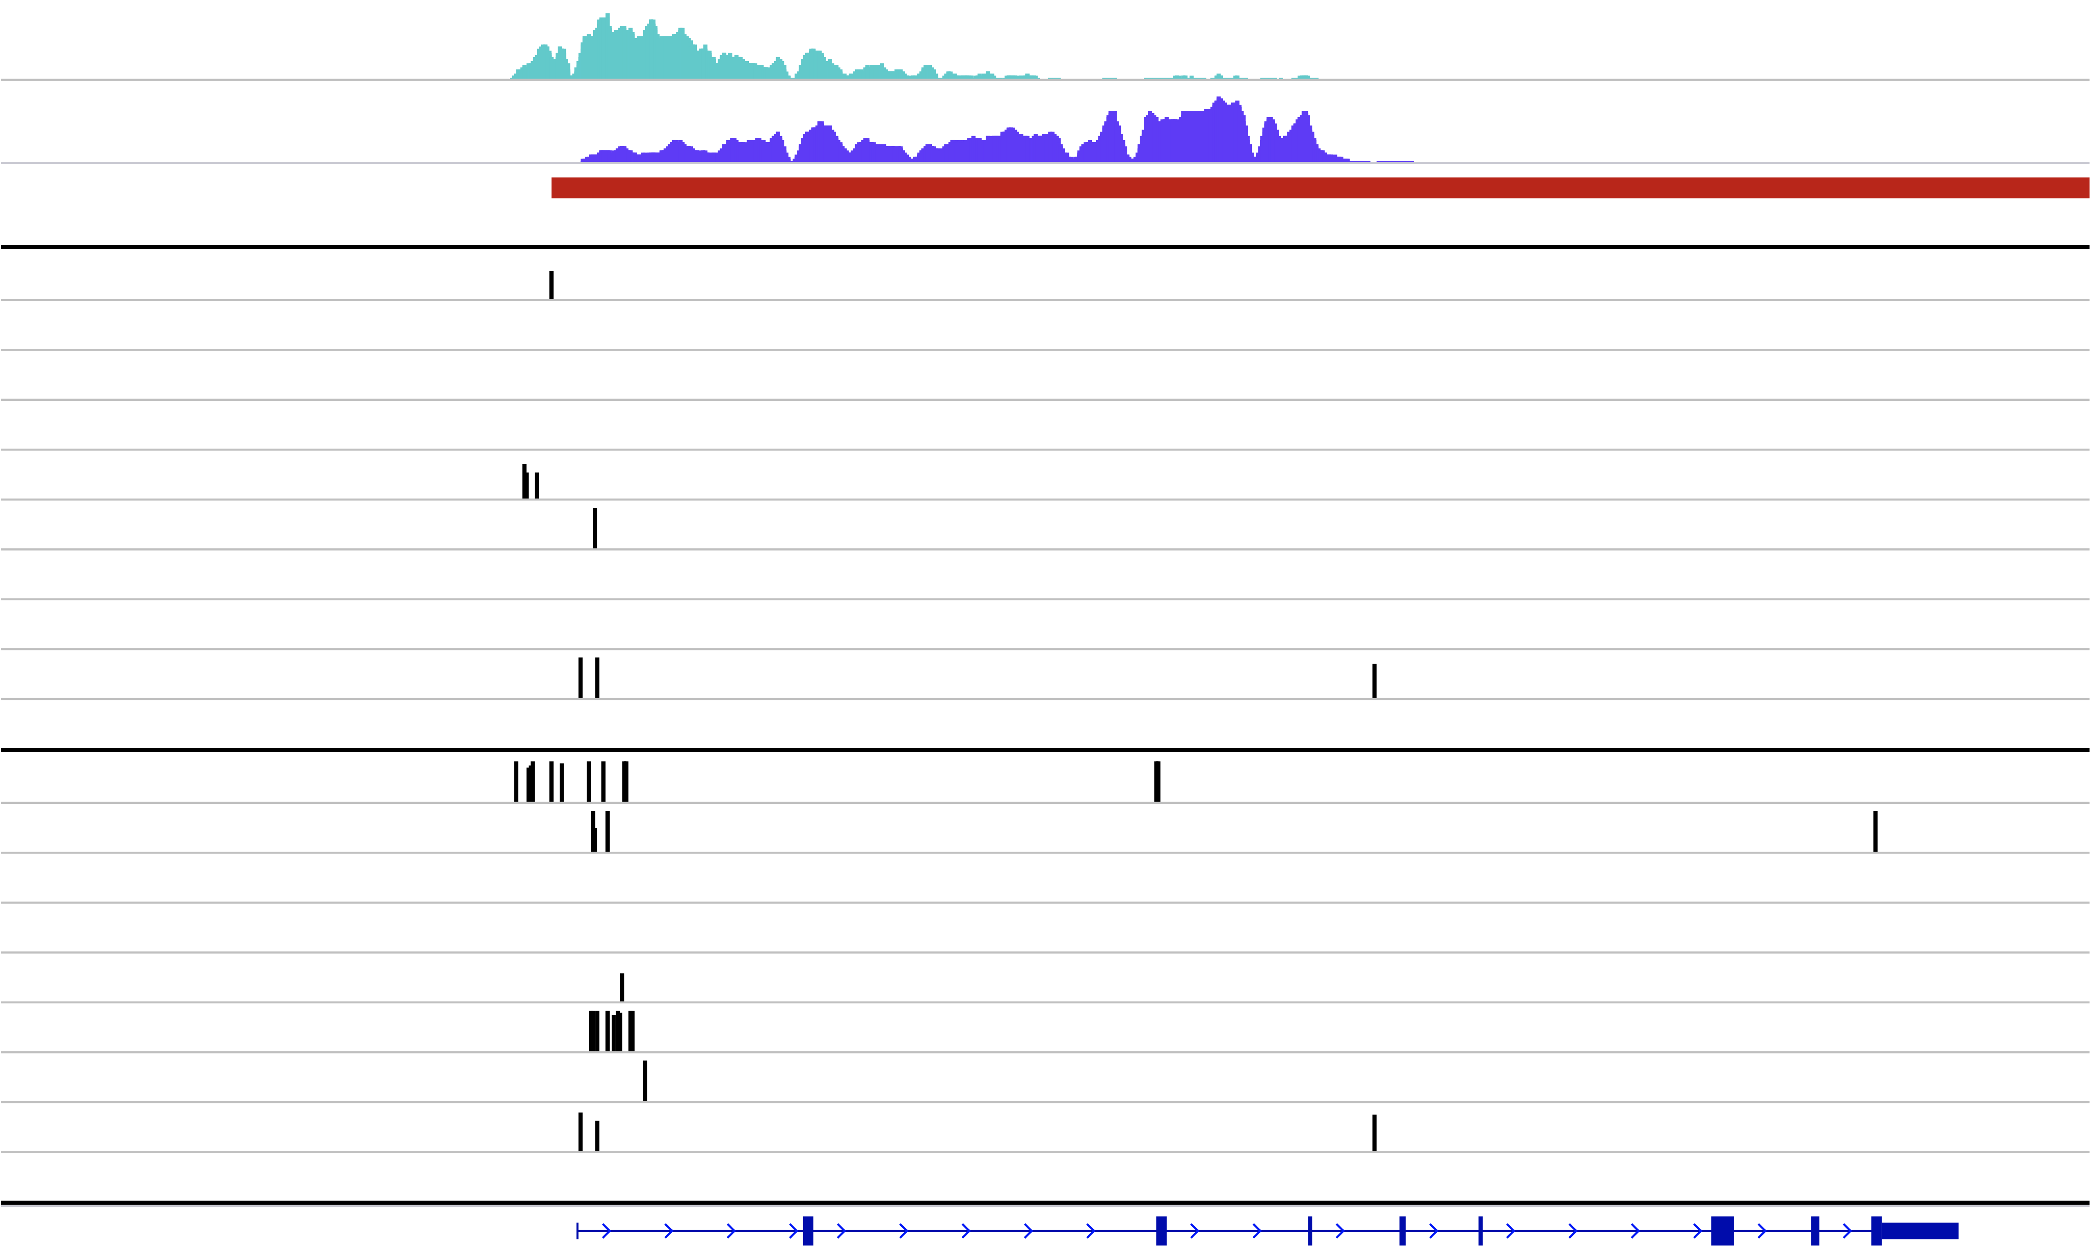
a.
Element annotation
10⁶
10⁴
10²
10⁰
Enhancer
Super-enhancer
FL
Inter-mutation distance (bp)
10⁶
10⁴
10²
10⁰
DHL
b.
6
4
2
0
-2
-4
-6
PAX5/ZCCHC7
ZFP36L1
DHL
BCL6, LPP
SEL1L3
LTB
MYC
FAM102A
DTX1
TCL1A
CIITA
IRF8
S1PR2
IgL
MIR3681HG
ST6GAL1
CD83
BLK
LHPP
BIRC3
BCL7A
IgH
SOCS1
BCL2
Difference in number of samples
harboring mutation
RHOH
BACH2
SGK1
PALM2AKAP2
POU2AF1
MYO16
MYO1E
VMP1
CXCR4
IMMP2L
BMP7
FL
CCNE2
3kb bins (n= 1,029,442; 3 GB)
Difference in number of mutations
Element annotation
c.
Enhancer
Super-enhancer
10⁶
10⁴
10²
10⁰
Chr16
FL
Inter-mutation distance (bp)
10⁶
10⁴
10²
10⁰
DHL
H3K27ac
SE
H3K4me3
H3K4me3
H3K27ac
H3K27ac
SE
SE
FL
FL
Somatic mutations
Somatic mutations
DHL
DHL
CIITA
IRF8
Figure 3: aSHM at Superenhancers
Figure 2
Notes:
BCL2 label in fig B and C

Slide 3
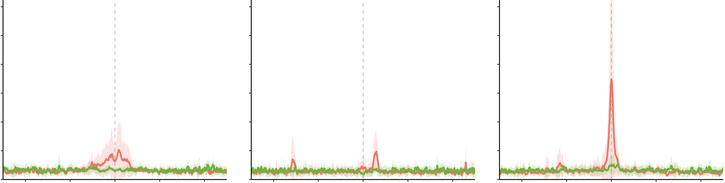
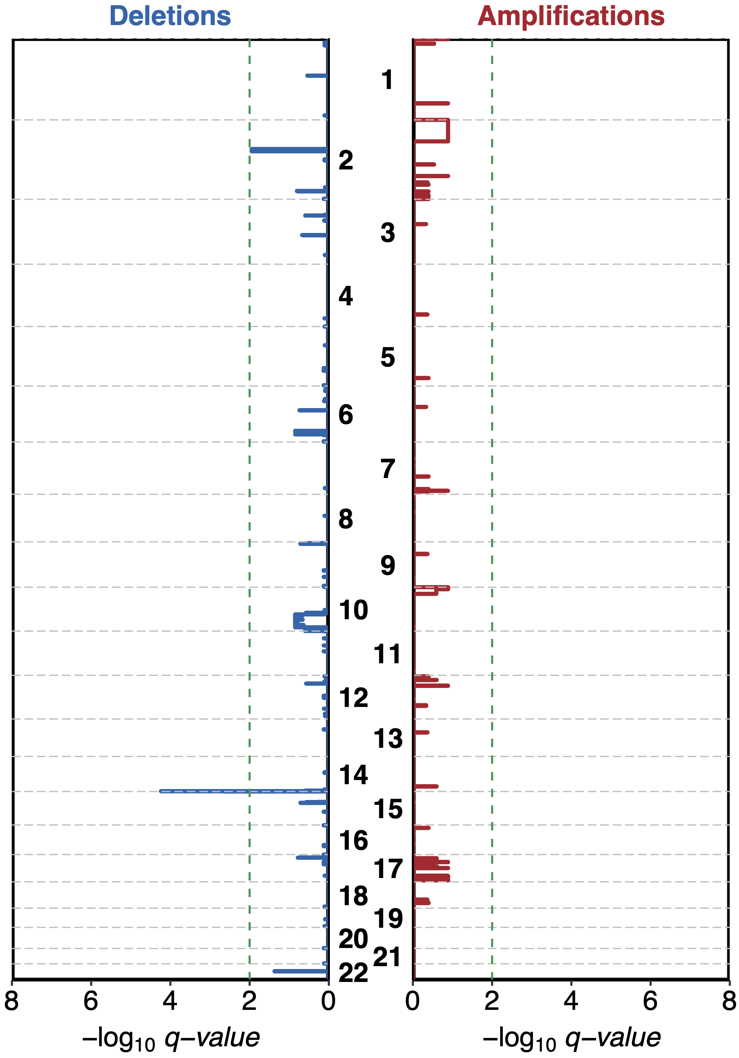
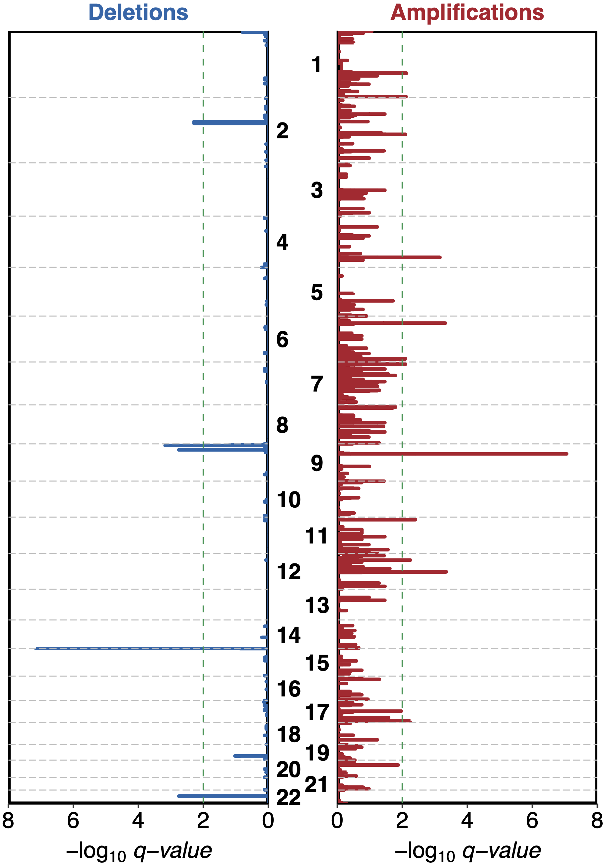
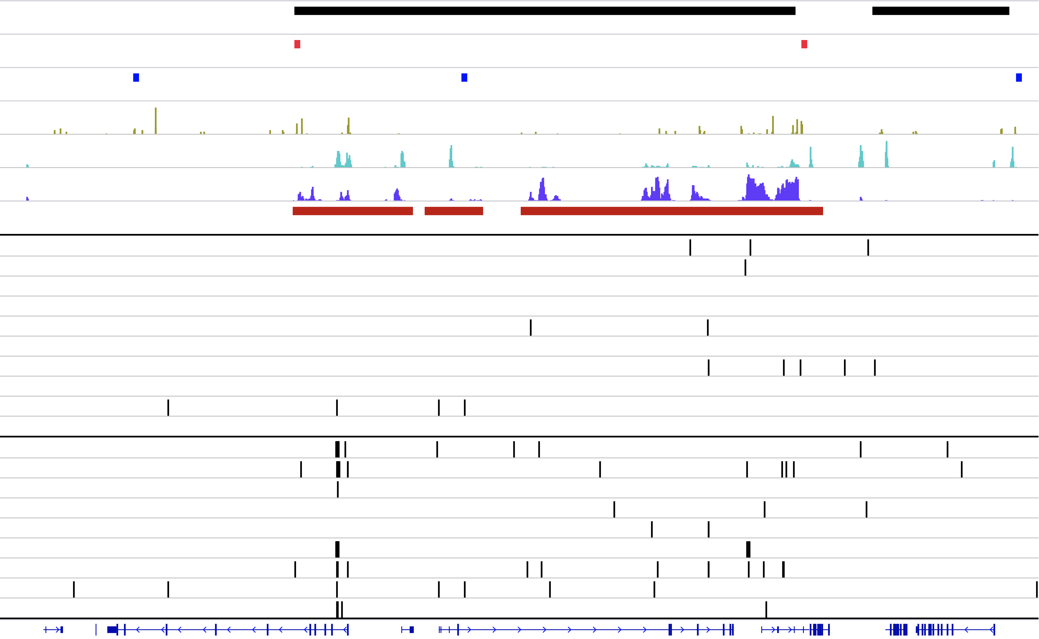
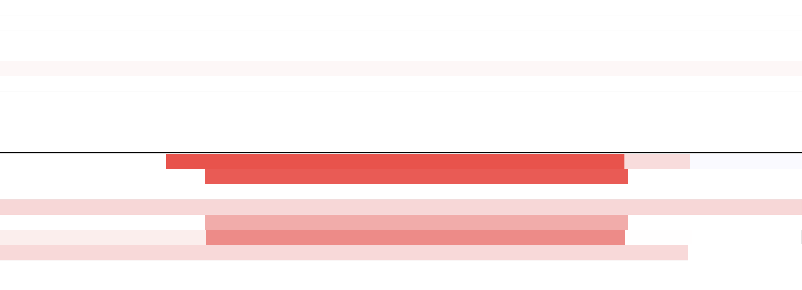
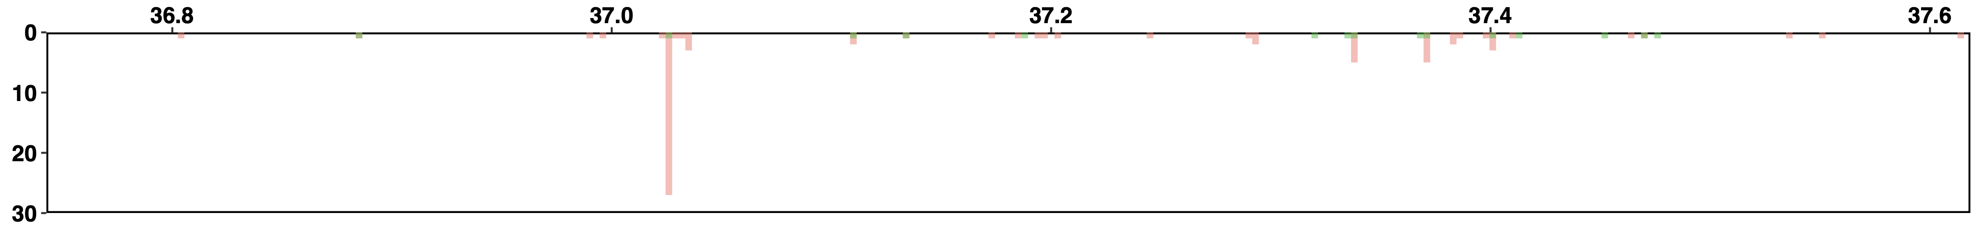
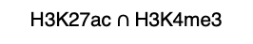
a.
0.6
H3K27ac - H3K4me3
0.6
H3K4me3 - H3K27ac
0.6
H3K27ac $∩$ H3K4me3
FL
0.5
0.5
0.5
DHL
0.4
0.4
0.4
Normalized mutation density
0.3
0.3
0.3
0.2
0.2
0.2
0.1
0.1
0.1
0
-80kb
-40kb
0
40kb
80kb
0
-80kb
-40kb
0
40kb
80kb
0
-80kb
-40kb
0
40kb
80kb
b.
Distance
c.
Distance
Distance
Deletions
FL
Amplifications
Deletions
DHL
Amplifications
1q23.1 (FCRL1)
2p11.2
2p11.2
1q44 (COX20)
(IgK)
(IgK)
2q22.1 (CXCR4)
4q31.3 (MND1)
6p22.2 (H1-4)
6q25.3 (SYTL3)
(MLANA)
7p21.3 (RPA3)
9p24.1
9p13.2 (PAX5, ZCCHC7)
9p21.3
(CDKN2A/B)
11p15.4 (WEE1)
12p12.1 (LOC645177)
14q32.33
14q32.33
12q15 (MDM2)
(IgH)
(IgH)
17q12 (IKZF3)
22q11.22
22q11.22
17q25.1 (SLC25A19)
(IgL)
8
6
4
2
0
0
2
4
6
8
(IgL)
8
6
4
2
0
0
2
4
6
8
-log10 (q-value)
-log10 (q-value)
d.
TAD
chr9:36,742,650-37,618,428
Strong boundary
Weak boundary
CTCF
H3K4me3
H3K27ac
SE region
P1
P2
P3
P4
FL
P5
P6
P7
P8.a
P8.b
P9
P1
P2
P3
P4
DHL
P5
P6
P7
P8
P9
PAX5
EBLN3P
ZCCHC7
LOC105376035
FBXO10
0
36.8Mb
37Mb
37.2Mb
37.4Mb
37.6Mb
10
Mutation count
Mutation enrichment (3 kb)
FL
20
DHL
30
Copy num. variation (log2)
-1.5
-0.3
0.3
1.5
Somatic
mutation
Scale
50 Kb
loss
gain
Figure 3

Slide 4
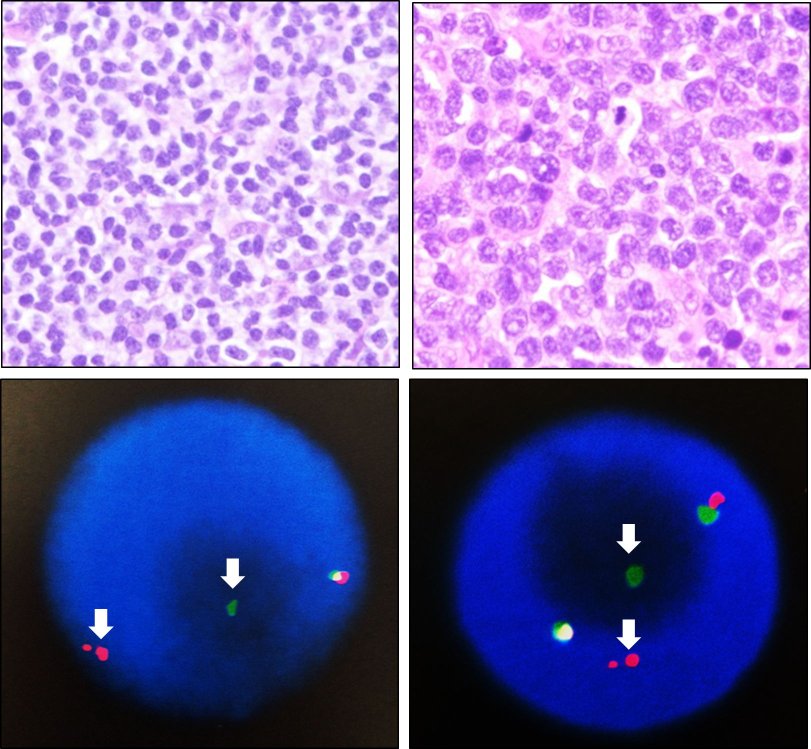
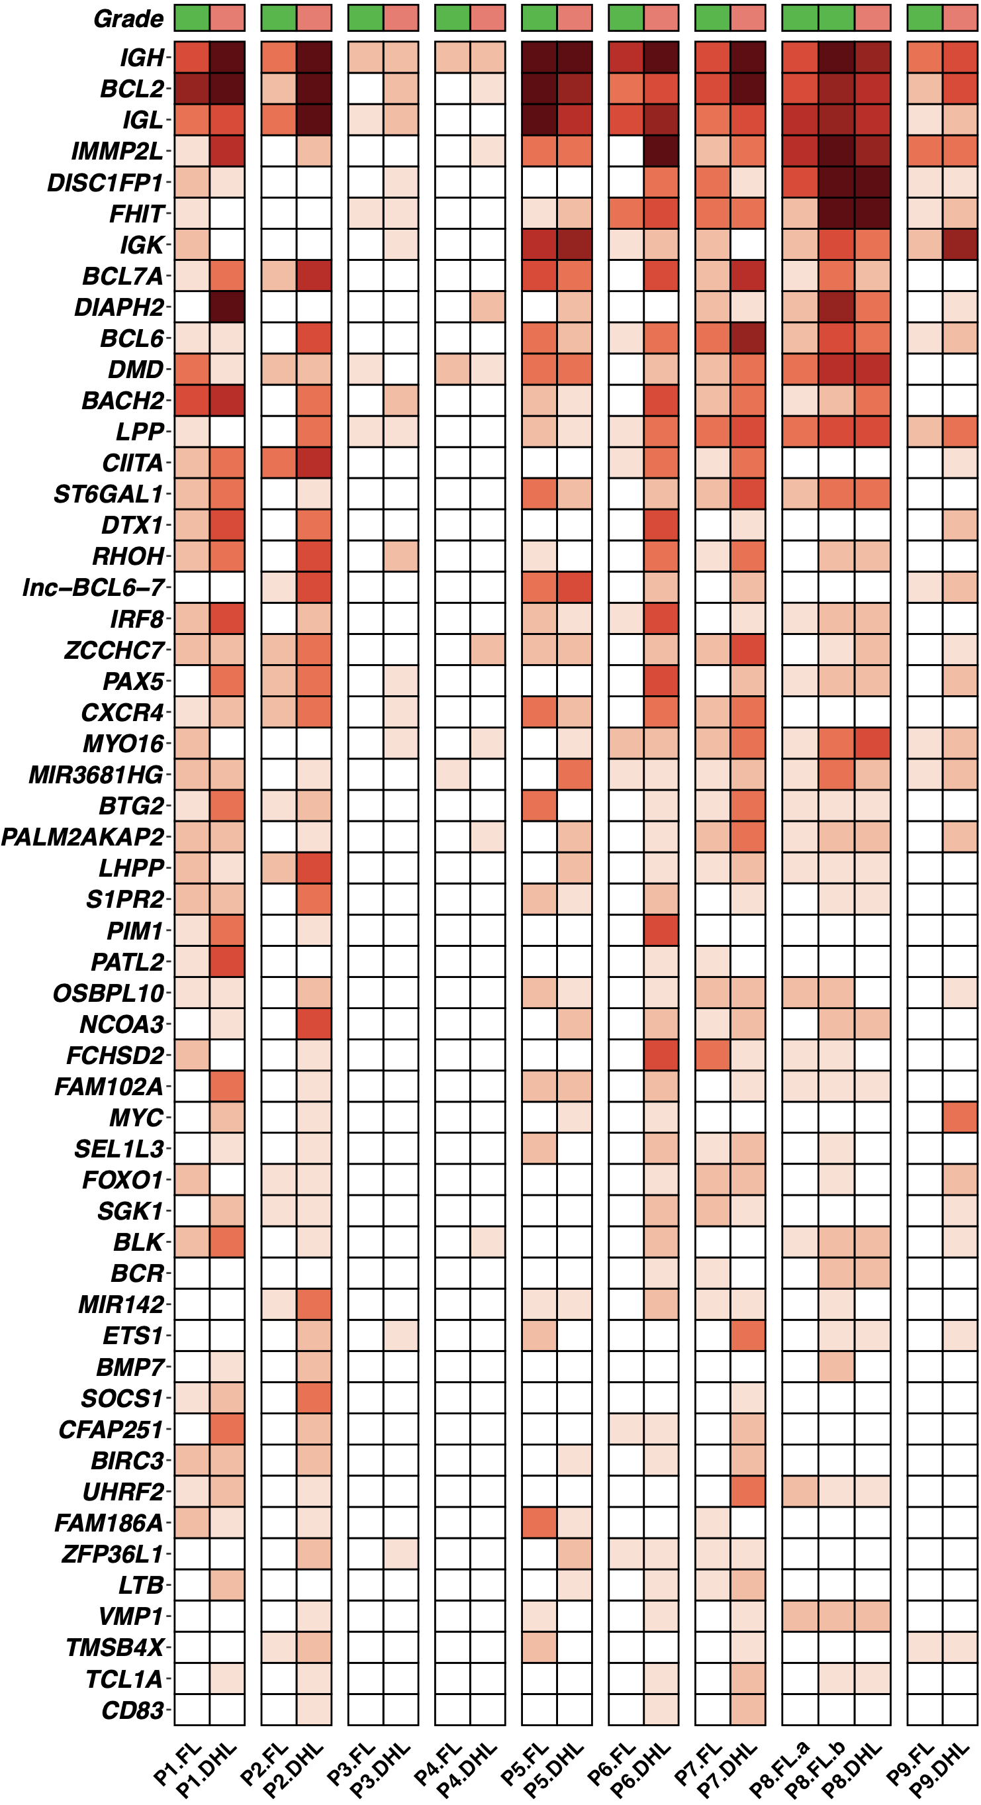
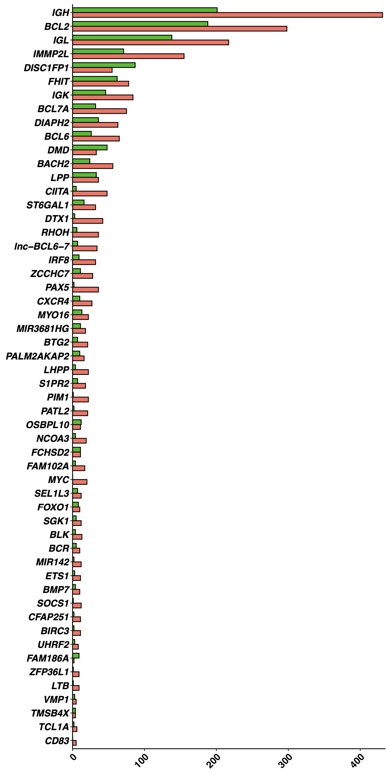
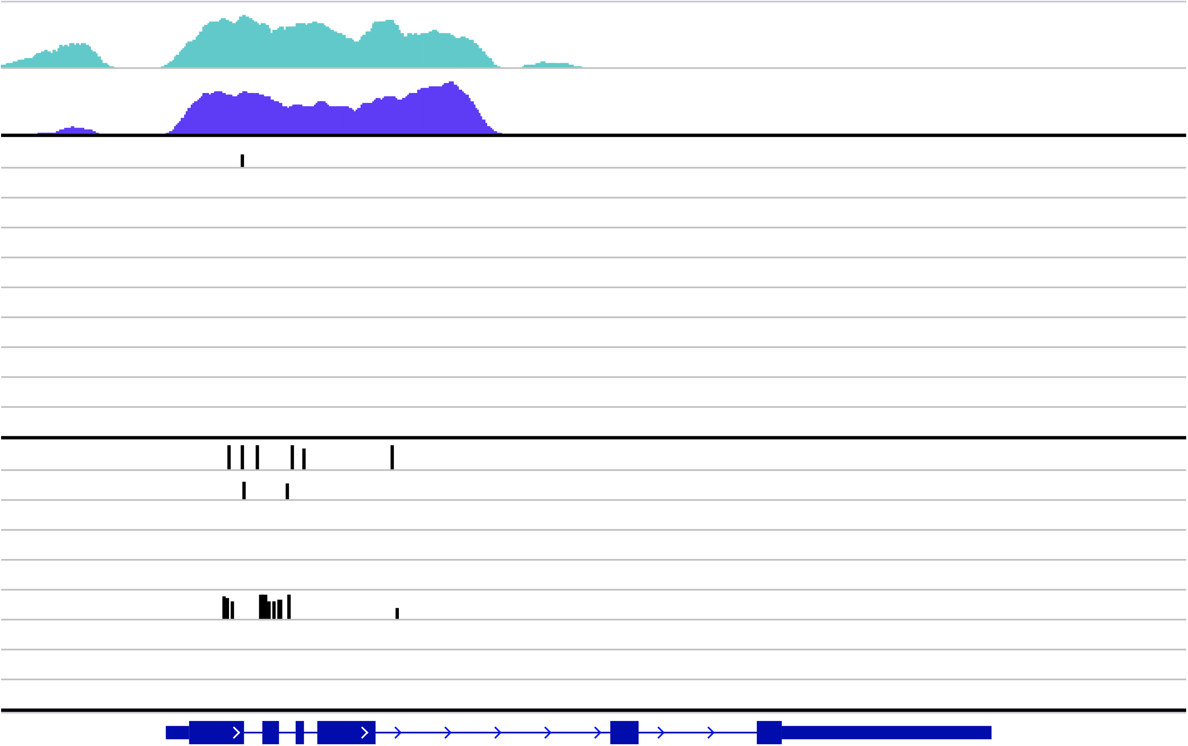
a.
FL
DHL
b.
c.
Intergenic
Coding
3’ UTR
100%
Intronic
5’ UTR
Chi-square test
p = 4.03 x 10⁻¹⁵
80%
3%
60%
Fraction of all somatic mutations
2%
40%
20%
1%
Grade
Gender
Mutation
FL
Male
Missense
Frame shift
Rearrangement
0
0
DHL
Female
In frame indel
Stop gained
Amplification
FL
DHL
FL
DHL
Splice site
Start lost
Deletion
d.
Total number of mutations
Total mutation number
e.
chr6:37,169,101-37,176,736
Somatic mutation
H3K4me3
H3K27ac
P1
P2
P3
P4
P5
P6
P7
P8.a
P8.b
P9
P1
P2
P3
P4
P5
P6
P7
P8
P9
FL
DHL
PIM1
Grade
Mut. number
FL
0
1
[2, 5)
[5, 10)
[10, 20)
[20, 30)
[30, 40)
>=40
DHL
Extended Figure 1

Slide 5
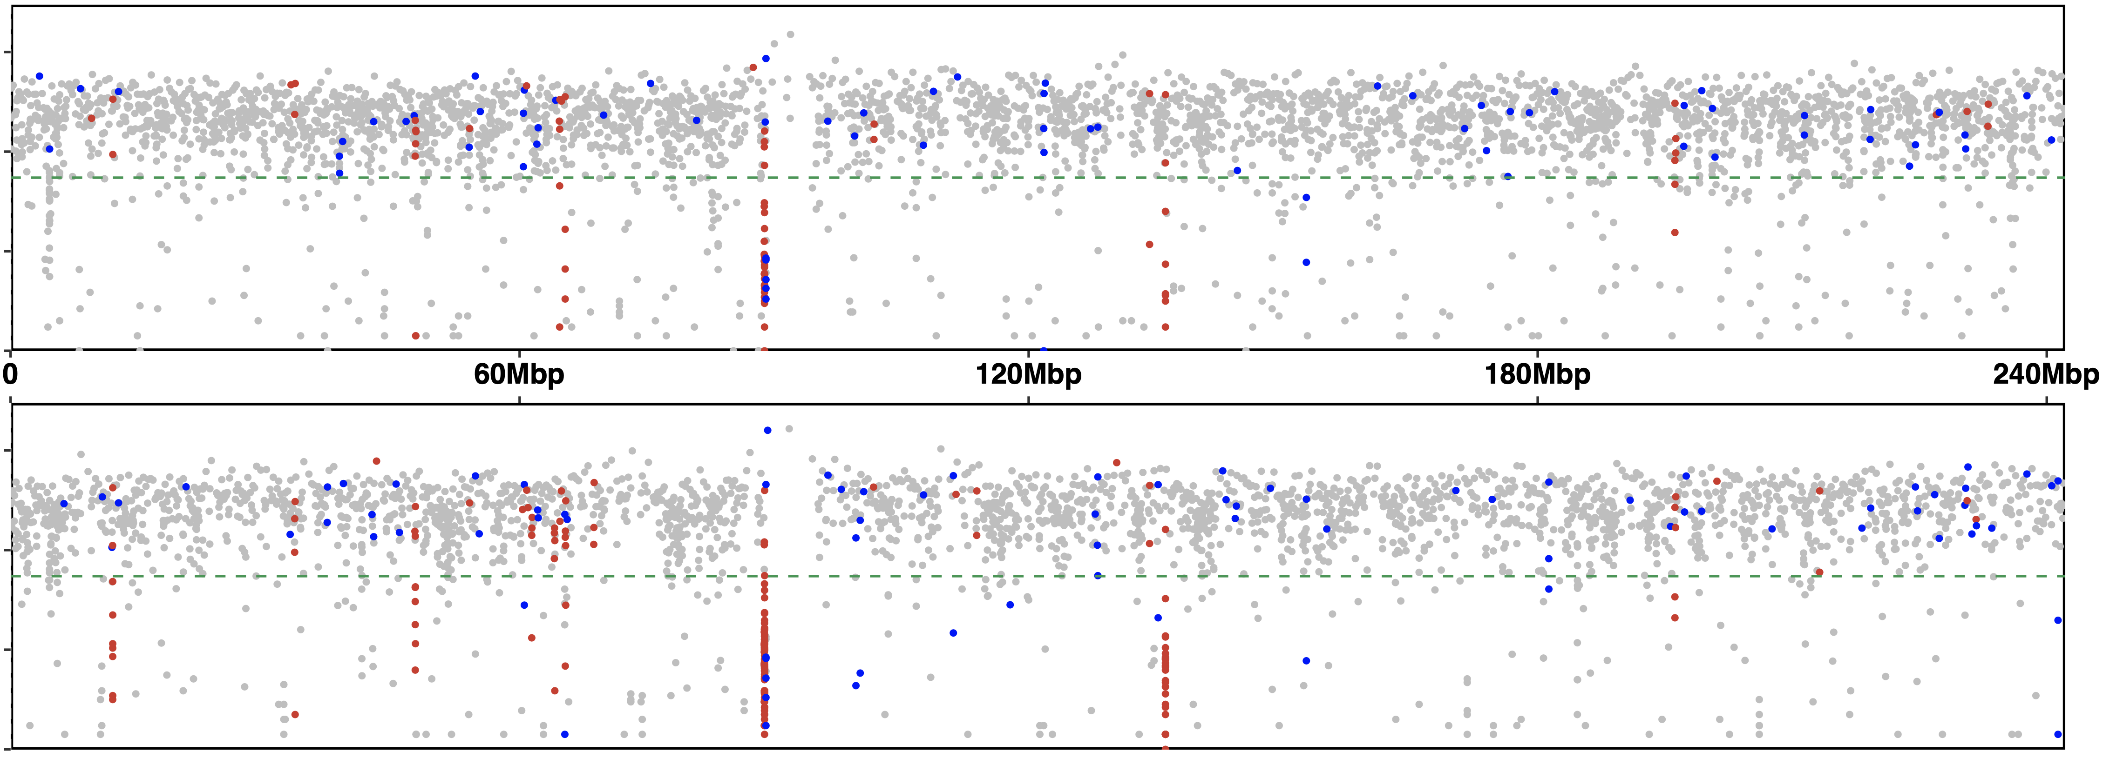
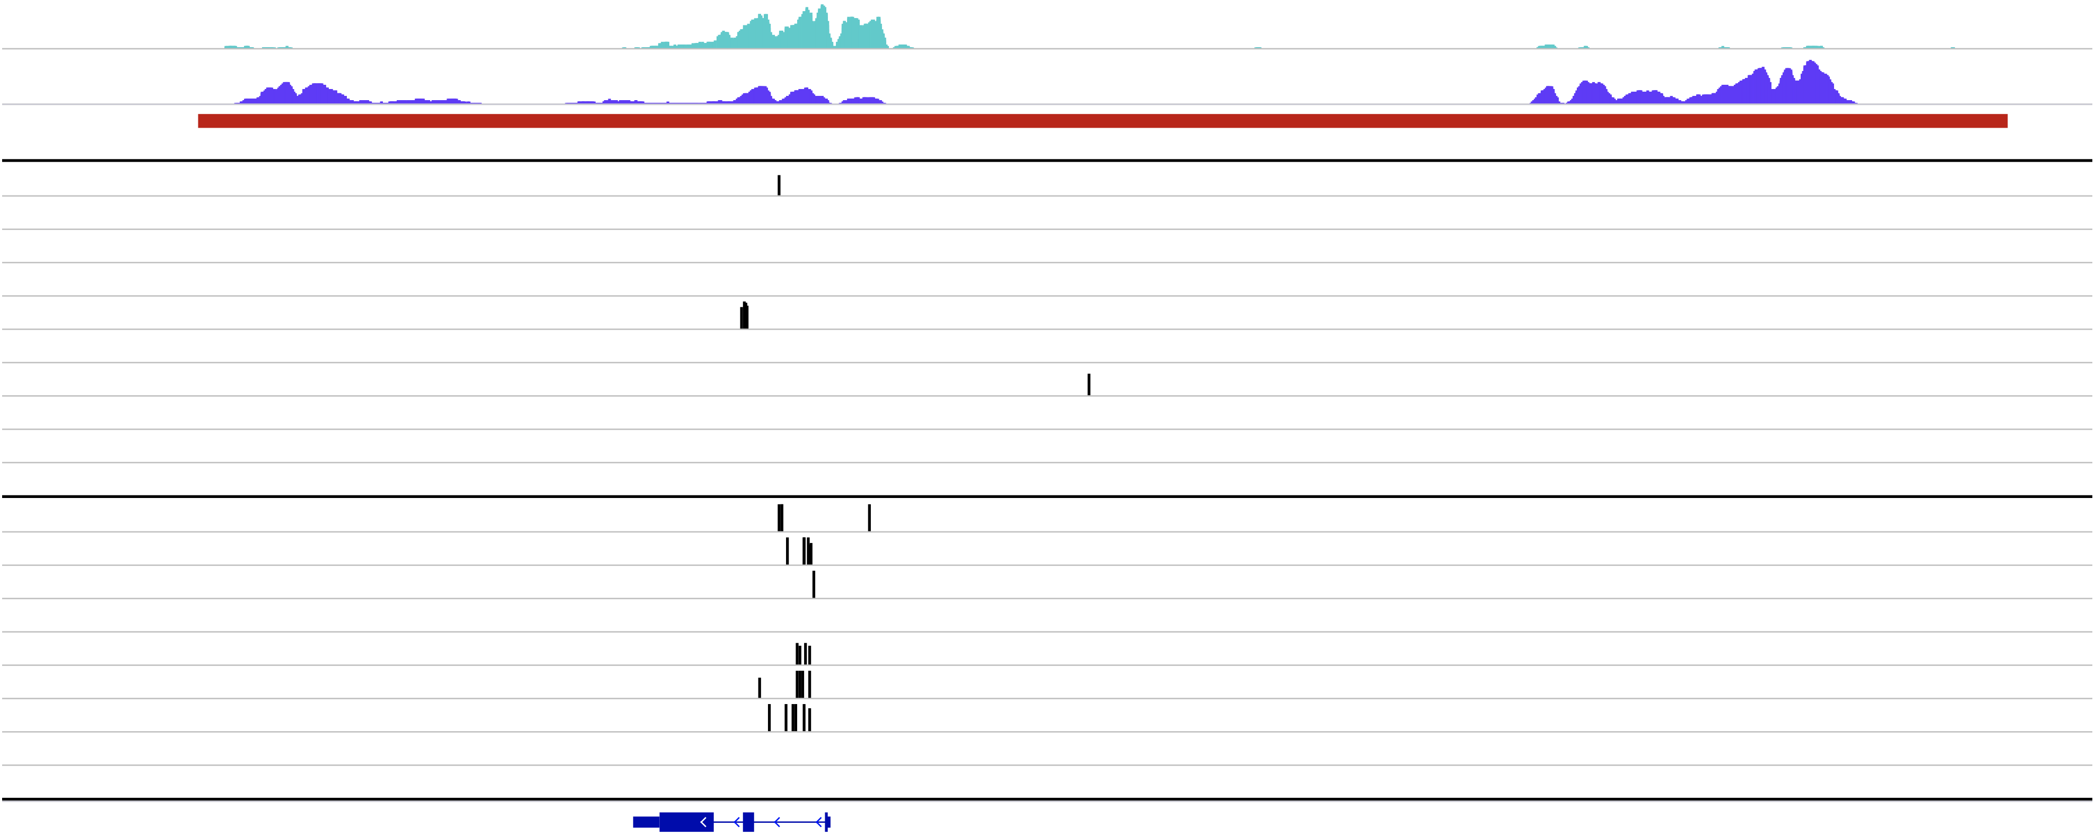
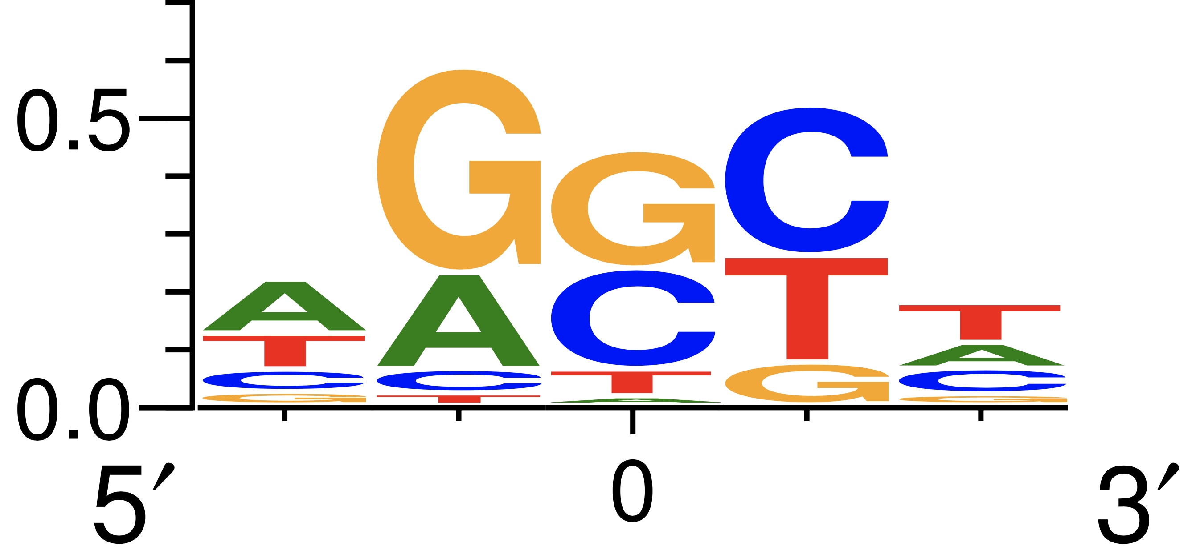
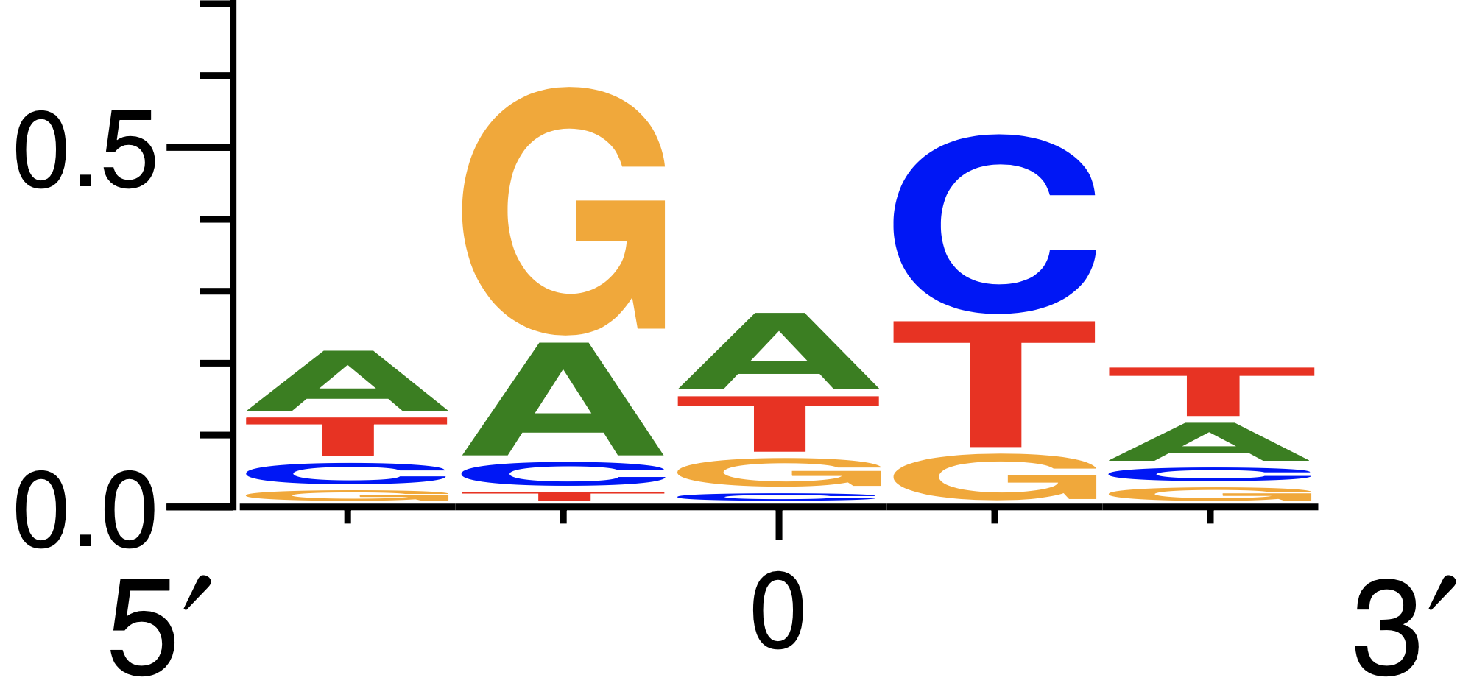
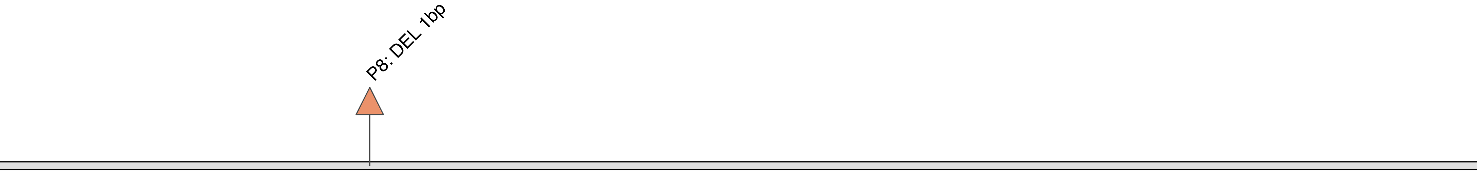
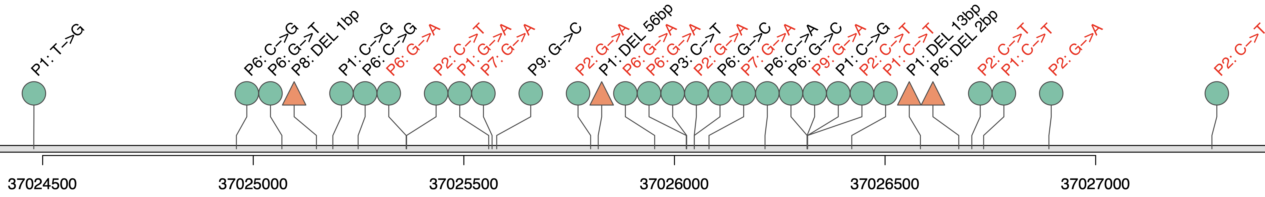
a.
Chr2
10⁶
10⁴
10²
10⁰
FL
Inter-mutation distance (bp)
10⁶
10⁴
10²
10⁰
DHL
H3K27ac
SE
b.
H3K4me3
H3K27ac
SE
P1
P2
P3
P4
P5
P6
P7
P8.a
P8.b
P9
P1
P2
P3
P4
P5
P6
P7
P8
P9
FL
Somatic mutations
DHL
CXCR4
c.
Chr9:37,024,400-37,027,400
FL
bits
mutation
Somatic mutations
5’
0
3’
5’
0
3’
DHL
Extended Figure 2

Slide 6
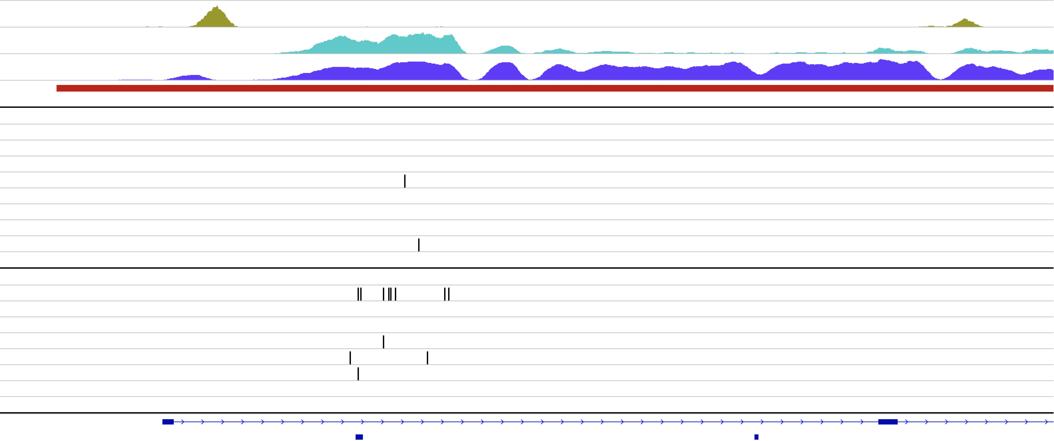
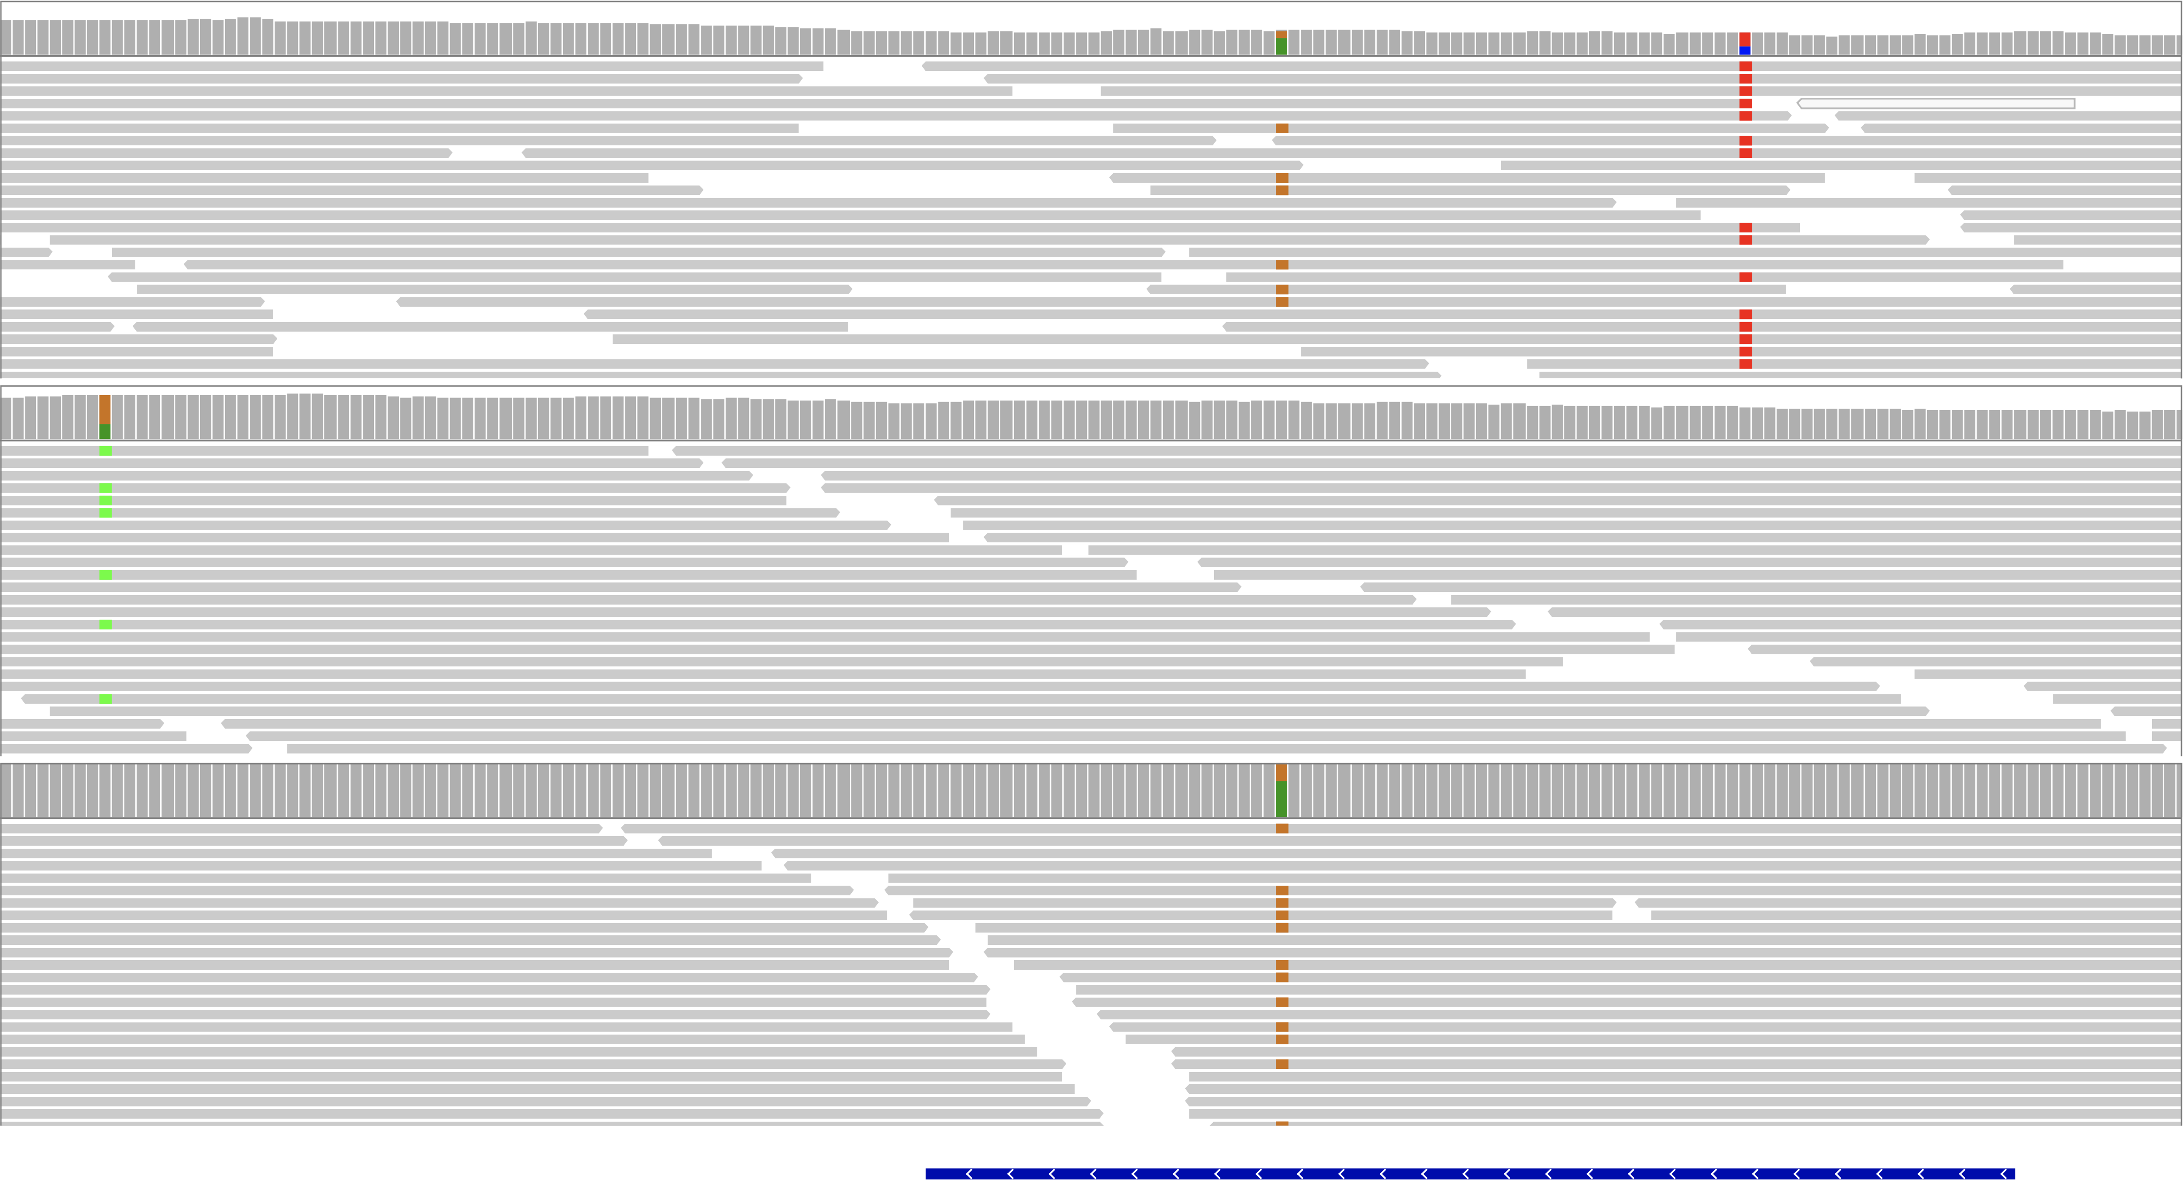
a.
CTCF
chr17:58,327,007-58,339,578
H3K4me3
H3K27ac
SE
P1
P2
P3
FL
P4
P5
P6
P7
P8.a
P8.b
P9
P1
P2
P3
DHL
P4
P5
P6
P7
P8
P9
TSPOAP1-AS1
MIR142
MIR4736
b.
chr17:58,331,158-58,331,332
[0 - 80]
P2.DHL
[0 - 80]
P6.DHL
[0 - 80]
P7.DHL
c.
MIR142
Case ID | Chr. | position | ref | alt | id.snp | Gene | Normal A.F. | FL A.F. | DHL A.F. | AID signature
P6 | chr17 | 58331166 | G | A | - | - | 0 | 0 | 0.34 | False
P2 | chr17 | 58331260 | A | G | rs756348475 | MIR142 | 0 | 0 | 0.33 | False
P7 | chr17 | 58331260 | A | G | rs756348475 | MIR142 | 0 | 0.14 | 0.54 | False
P2 | chr17 | 58331297 | C | T | - | MIR142 | 0 | 0 | 0.58 | True
G to A (P2)
MIR142
5’ ---
 |  |  |  |  |  |  |  |  |  |  |  |  |  |  |  |  |  |  |  |  |  |  |  |  |  |  |  |  |  |  |  |  |  |  |  | A | C | A | G
 |  |  |  |  |  |  |  |  |  |  |  |  |  |  |  |  |  |  |  |  |  |  |  |  |  |  |  |  |  |  |  |  |  |  | A |  |  |  |  | C
A | C | A | G | U | G | C | A | G | U | C | A | C | C | C | A | U | A | A | A | G | U | A | G | A | A | A | G | C | A | C | U | A | C | U |  |  |  |  |  |  | A
| | | | | | | | | |  | | | | | | | | | | | | |  | | | | | | | | | | | | | | | | | | | | | | |  | | | | |  | | | | | | | | | | | | |  |  |  |  |  |  |  | C
U | G | U | C | A | U | G | U | G | A | G | U | A | G | G | U | A | U | U | U | C | A | U | C | C | U | U | U | G | U | G | A | U | G | U |  |  |  |  |  |  | U
 |  |  |  |  |  |  |  |  |  |  |  |  |  |  |  |  |  |  |  |  |  |  |  |  |  |  |  |  |  |  |  |  |  |  | G |  |  |  |  | G
 |  |  |  |  |  |  |  |  |  |  |  |  |  |  |  |  |  |  |  |  |  |  |  |  |  |  |  |  |  |  |  |  |  |  |  | G | G | A | G
3’ ---
U to C (P2, P7)
Extended Figure 3

Slide 7

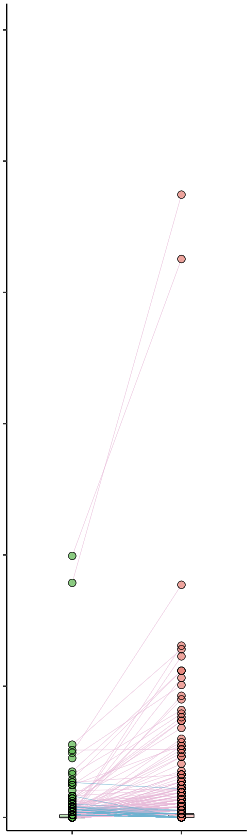
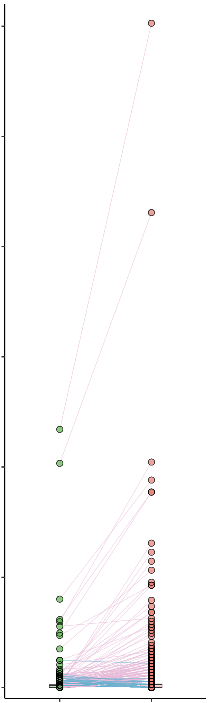
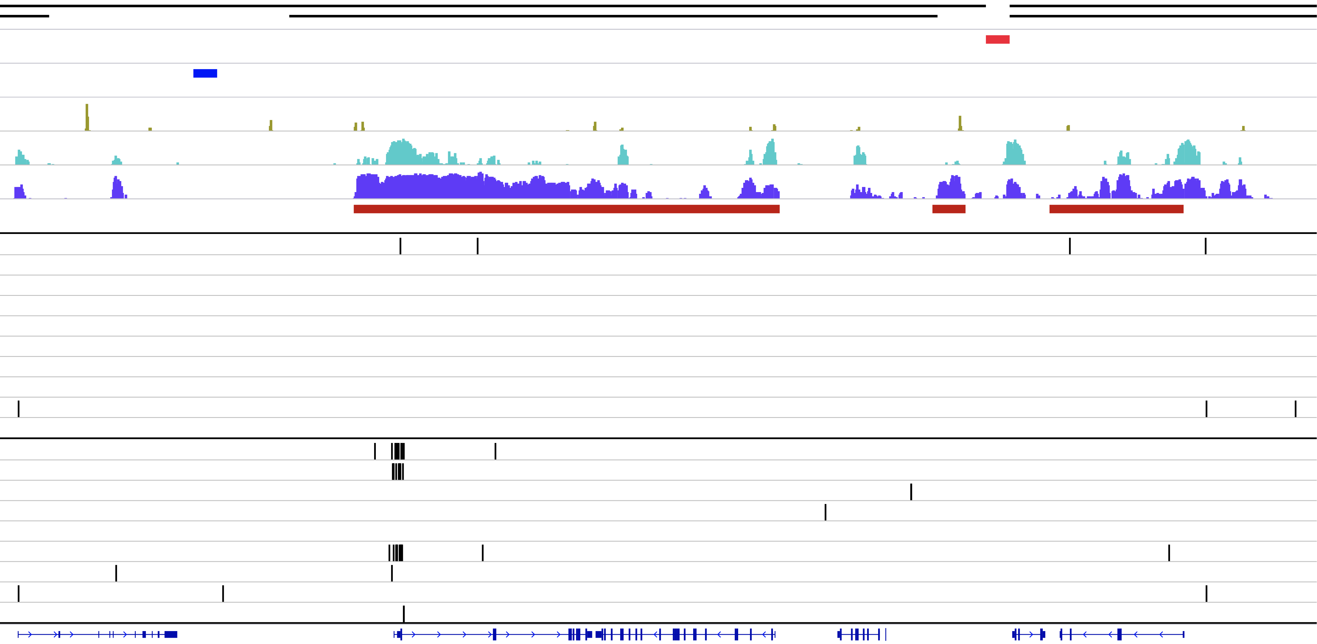

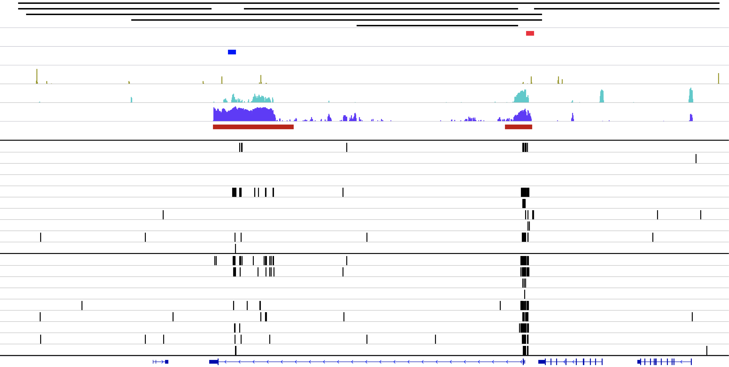
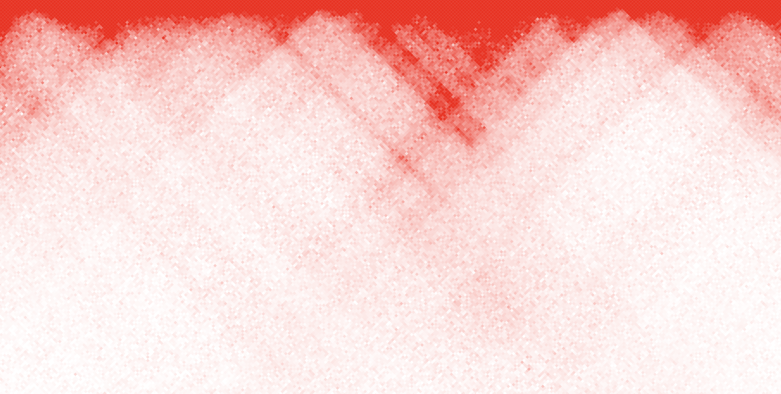
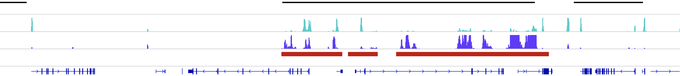
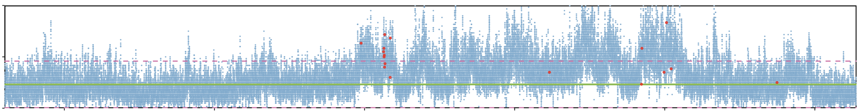
a.
p = 3.4 x 10⁻⁹⁰
p = 6.5 x 10⁻¹⁰²
b.
0.6
0.6
BCL2
chr12:112974640-113249925
TAD
0.5
0.5
Strong boundary
BCL2
Weak boundary
CTCF
IgH
H3K4me3
IgH
H3K27ac
0.4
0.4
SE
Percentage of mutations overlapped with H3K4me3 peaks
Percentage of mutations overlapped with H3K27ac peaks
FL
0.3
0.3
Somatic mutations
BCL7A
DHL
0.2
BCL6
0.2
BCL6
OAS2
DTX1
RASAL1
CFAP73
RITA1
IQCD
CIITA
IgK
BCL7A
CIITA
c.
BACH2
DTX1
0.1
DTX1
0.1
BACH2
PAX5
RHOH
IgK
PAX5
chr18:62,993,557-63,447,650
0
RHOH
0
FL
DHL
FL
DHL
TAD
Strong boundary
Fisher’s exact test p < 2.2 x 10⁻¹⁶ | Mutations in H3K4me3 | Mutations not in H3K4me3
FL | 1250 | 47426
DHL | 2606 | 34065
Weak boundary
CTCF
H3K4me3
H3K27ac
SE
Fisher’s exact test p < 2.2 x 10⁻¹⁶ | Mutations in H3K27ac | Mutations not in H3K27ac
FL | 1933 | 46743
DHL | 3436 | 33235
FL
Somatic mutations
d.
DHL
XR_935570.2
BCL2
KDSR
VPS4B
chr9:36,520,268-37,655,536
TAD
H3K4me3
H3K27ac
SE
MELK
PAX5
EBLN3P
ZCCHC7
LOC105376035
60
FBXO10
Reads coverage
of P2.DHL
30
0
36.6Mb
36.8Mb
37Mb
37.2Mb
37.4Mb
37.6Mb
Mean coverage of whole sample
2 x standard deviation boundaries
Somatic mutation
Extended Figure 4

Slide 8
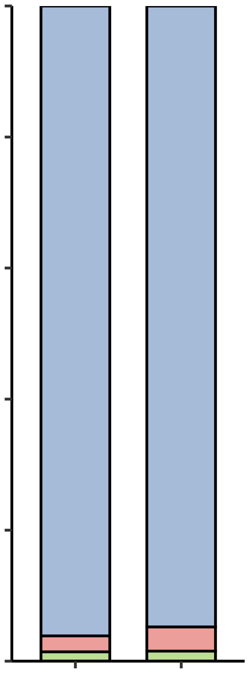
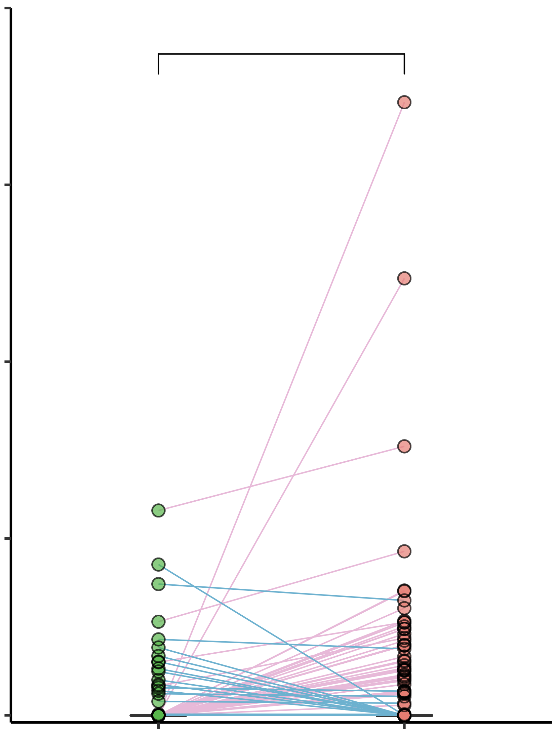




a.
Single nucleotide substitution
100%
Microdeletion
Microinsertion
0.2
p = 3.60 x 10⁻⁵
80%
Chi-square test
p = 1.08 x 10⁻⁶
0.15
BCL2
60%
5%
CIITA
4%
Normalized density of microdeletion in all super-enhancers
Fraction of all somatic mutations
3%
0.1
IgH
40%
2%
BCL6
20%
0.05
ASB2
1%
PAX5
0
FL DHL
0
FL DHL
0
FL
DHL
Fisher’s exact test p = 1.16 x 10⁻⁵ | Microdeletion in SE | Microdeletion not in SE
FL | 20 | 1167
DHL | 65 | 1291
0.25
FL
0.2
DHL
0.15
Density of microdeletion ( /Mb)
Fisher’s exact test p = 0.012 | Microinsertion in SE | Microinsertion not in SE
FL | 13 | 677
DHL | 25 | 536
0.1
0.05
0
-200
-150
-100
-50
0
50
100
150
200
b.
Distance to super-enhancer regions (Kb)
30
Chr9:36,520,268-37,655,536
15
WGS somatic mutation from Xose S, et al
CLL
MBL
0
SLL
30
WGS somatic mutation from Morin, et al
DLBCL
15
Mutation counts
0
30
WGS somatic mutation in this study
FL
15
DHL
0
36.6Mb
36.8Mb
37Mb
37.2Mb
37.4Mb
37.6Mb
H3K4me3
H3K27ac
SE
MELK
PAX5
EBLN3P
ZCCHC7
LOC105376035
FBXO10
Extended Figure 5

Slide 9




a.
Hypermutations on PAX5 promotor
No mutations detected on ZCCHC7 promotor
DHL
mutations
H3K27ac
H3K4me3
CTCF
…
…
…
Toledo
RNA
NU-DHL-1
RNA
OCI-LY3
RNA
Transcripts
B
b.
PAX5
ZCCHC7
367 potential
ER gene pairs
from Soohwan, et al.
Find significant negative correlation gene pairs in 11 DLBCL cell lines
Clustering 106 DLBCL tumor RNA via these genes
Testing association between hypermutation and clusters for each hypermutation loci
143 gene pairs from 25 hypermutation loci of 48 DLBCL samples
d.
Intronic enhancer stimulating ZCCHC7 promoter
SUDHL10
Normalized coverage
SUDHL10
𝜟PAX5-TSS2
SUDHL10
SUDHL10
𝜟PAX5-TSS2
c.
e.
**
**
Fold change of Pax5^{Mut}clone over WT clone
normalized on GAPDH
Pax5
ZCCHC7
Extended Figure 6

